Slide 1
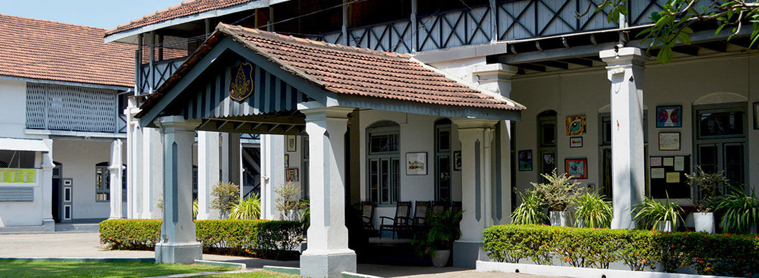
Bishop’s College Past Pupils’ Association
Annual General Meeting 2023

Slide 2
The last few years have been challenging…
But, however tough it became, we persevered
We pulled through…
Let us now take a walk down memory lane

Slide 3
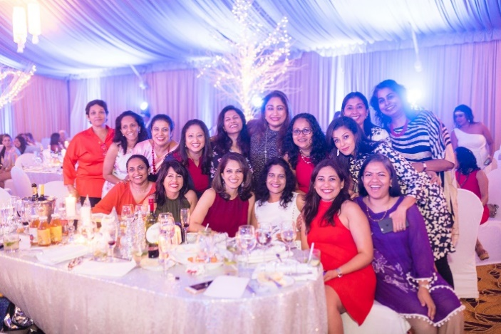
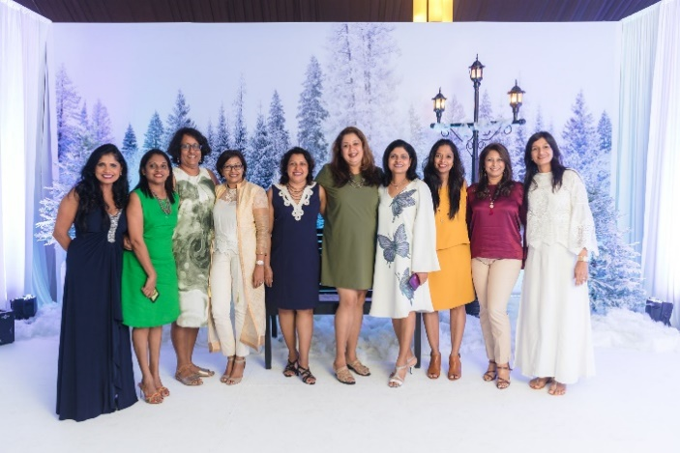
ICE 2019
A White Christmas organized by batch of ‘92 & BC PPA

Slide 4
ICE 2019
A White Christmas organized by batch of ‘92 & BC PPA

Slide 5
ICE 2019
A White Christmas organized by batch of ‘92 & BC PPA

Slide 6
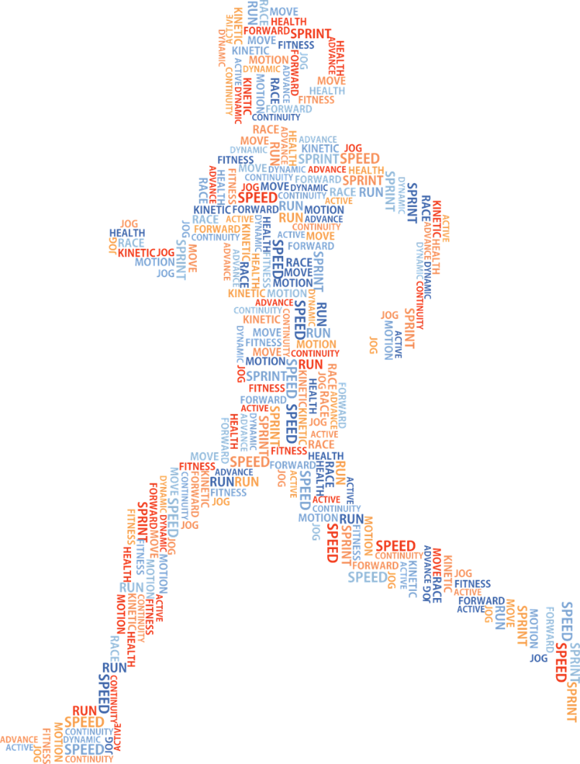
S
P
O
R
T
S
MEET 2020

Slide 7
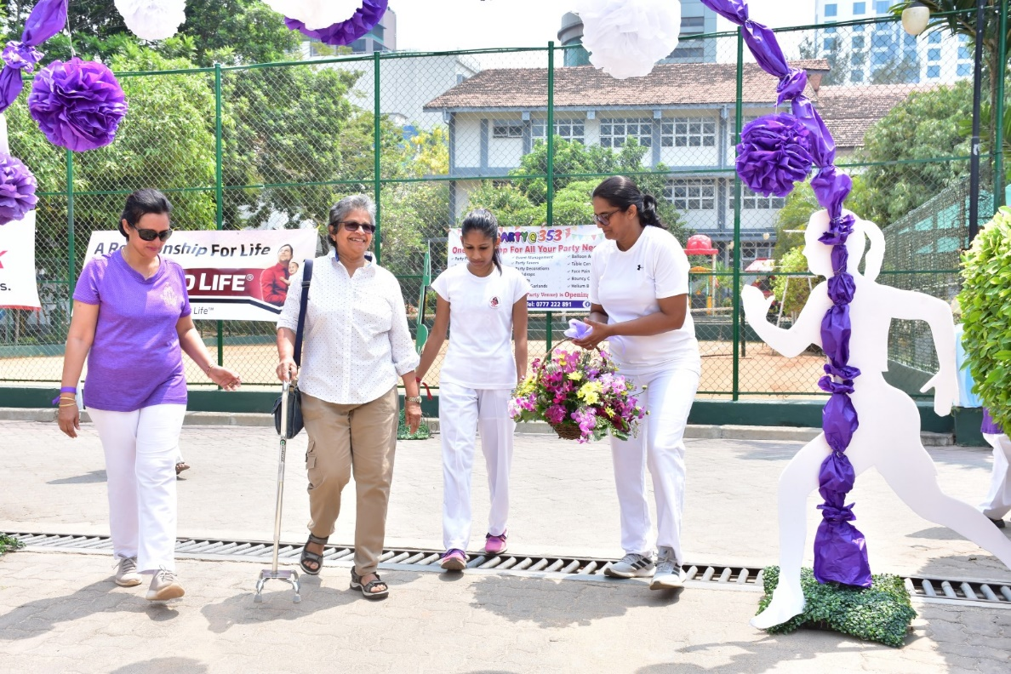
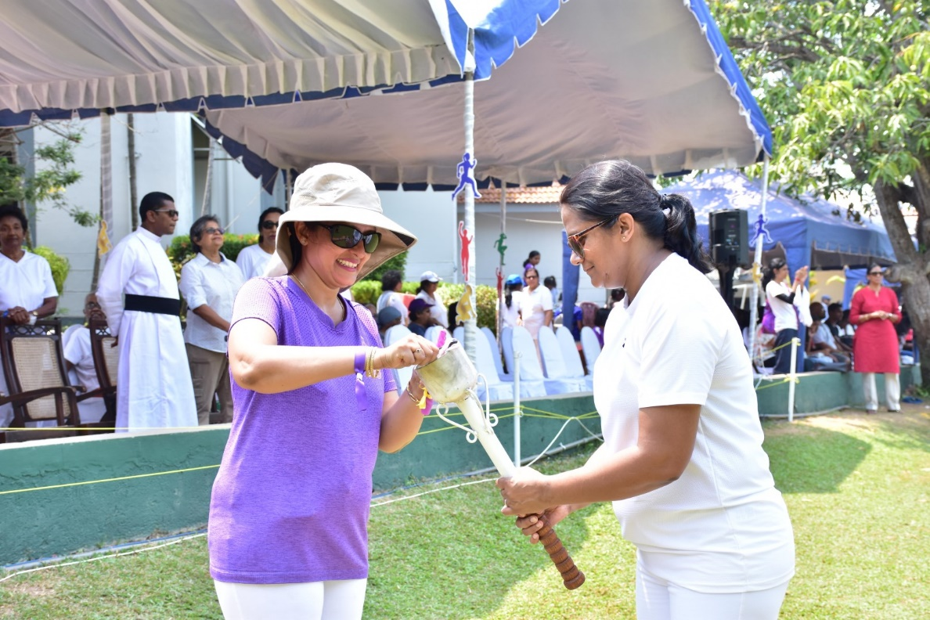
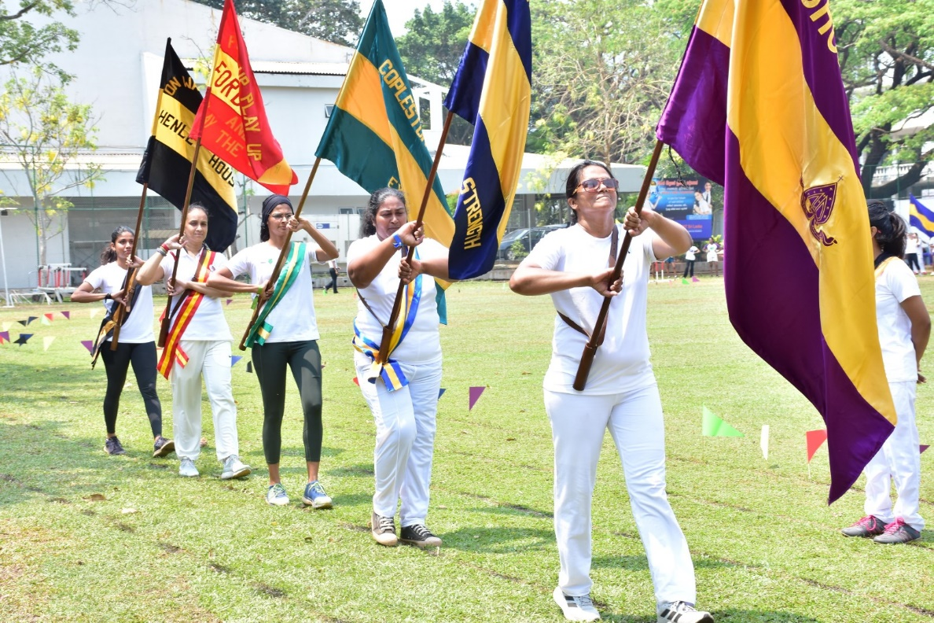
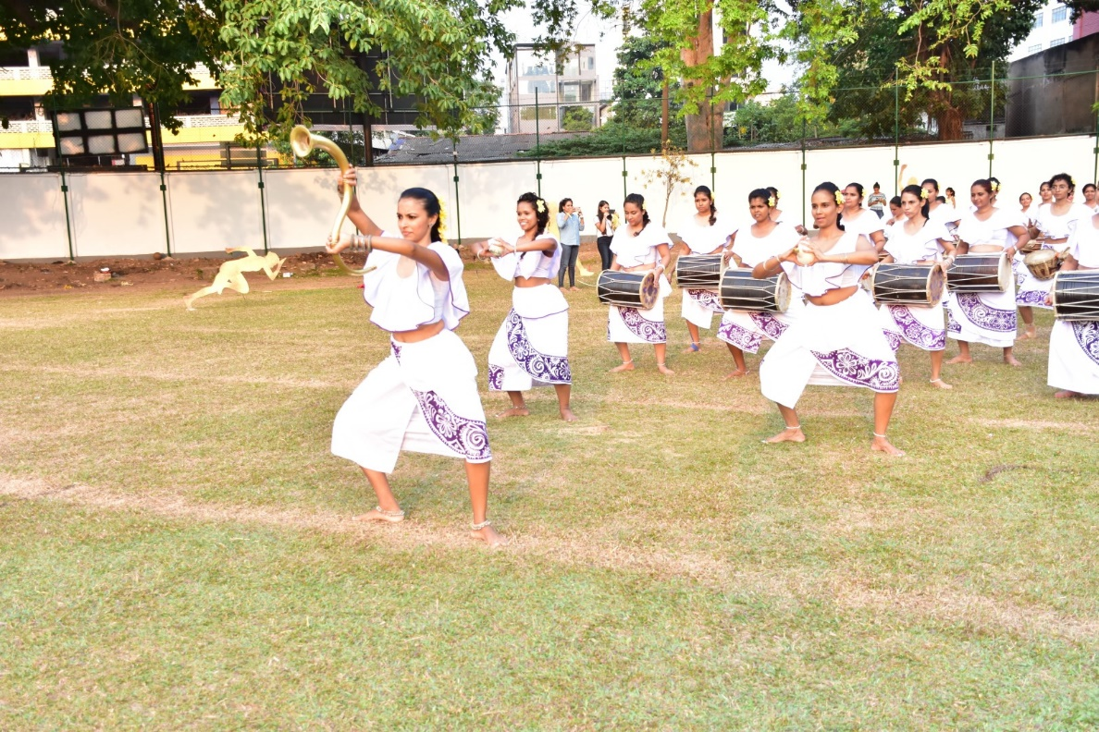
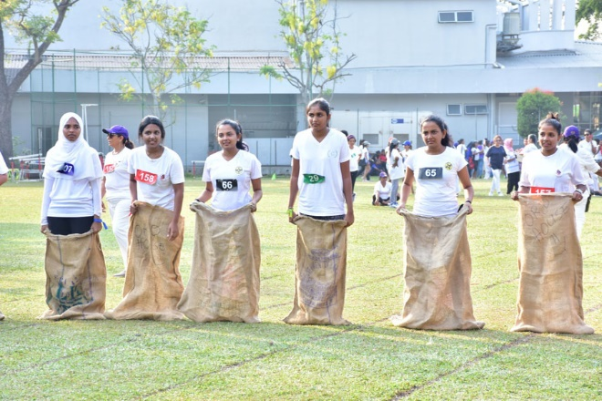
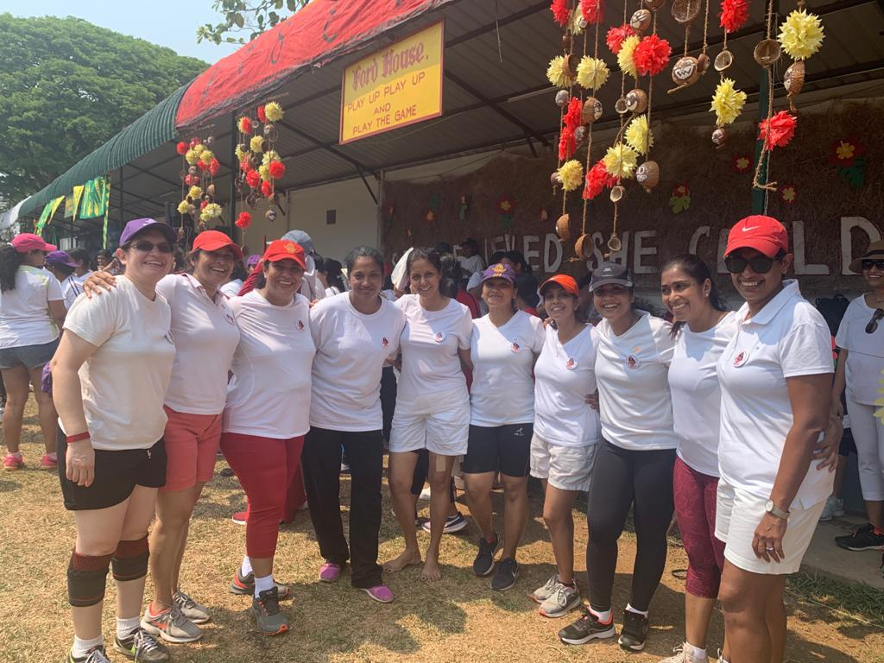

Slide 8
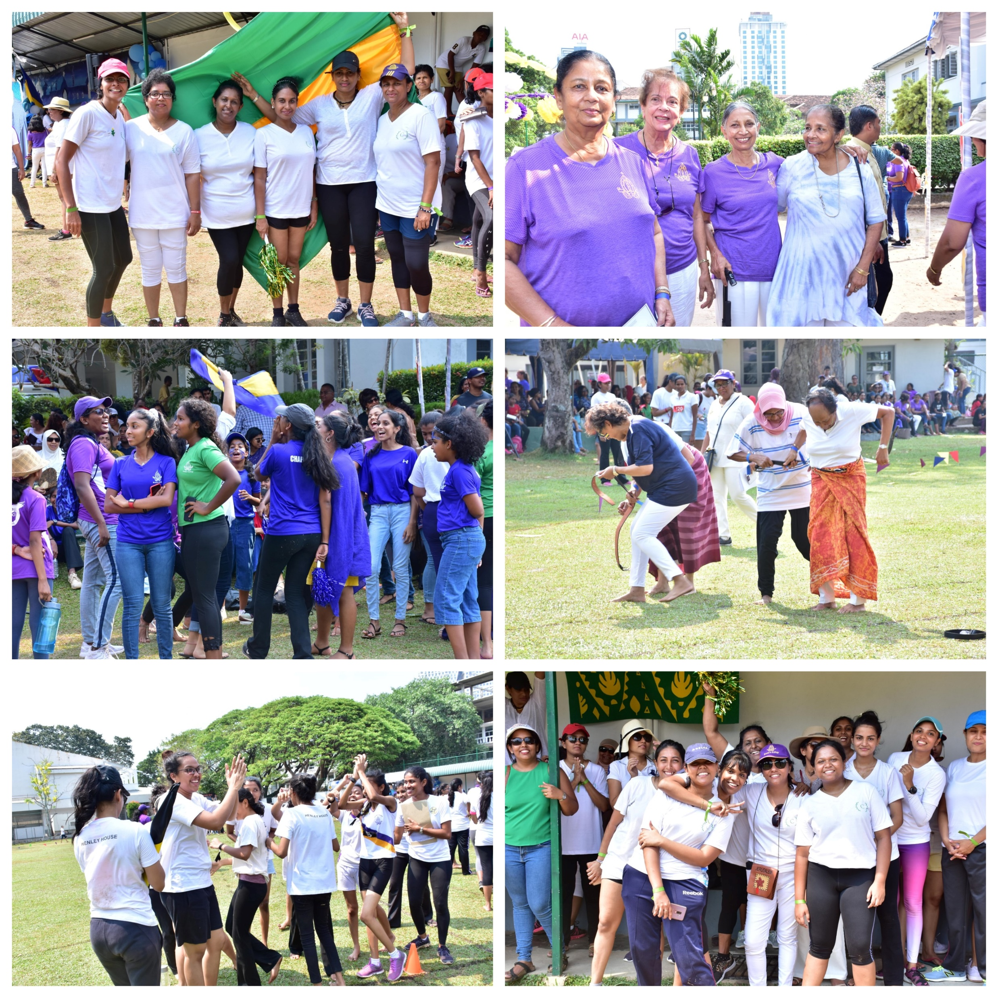
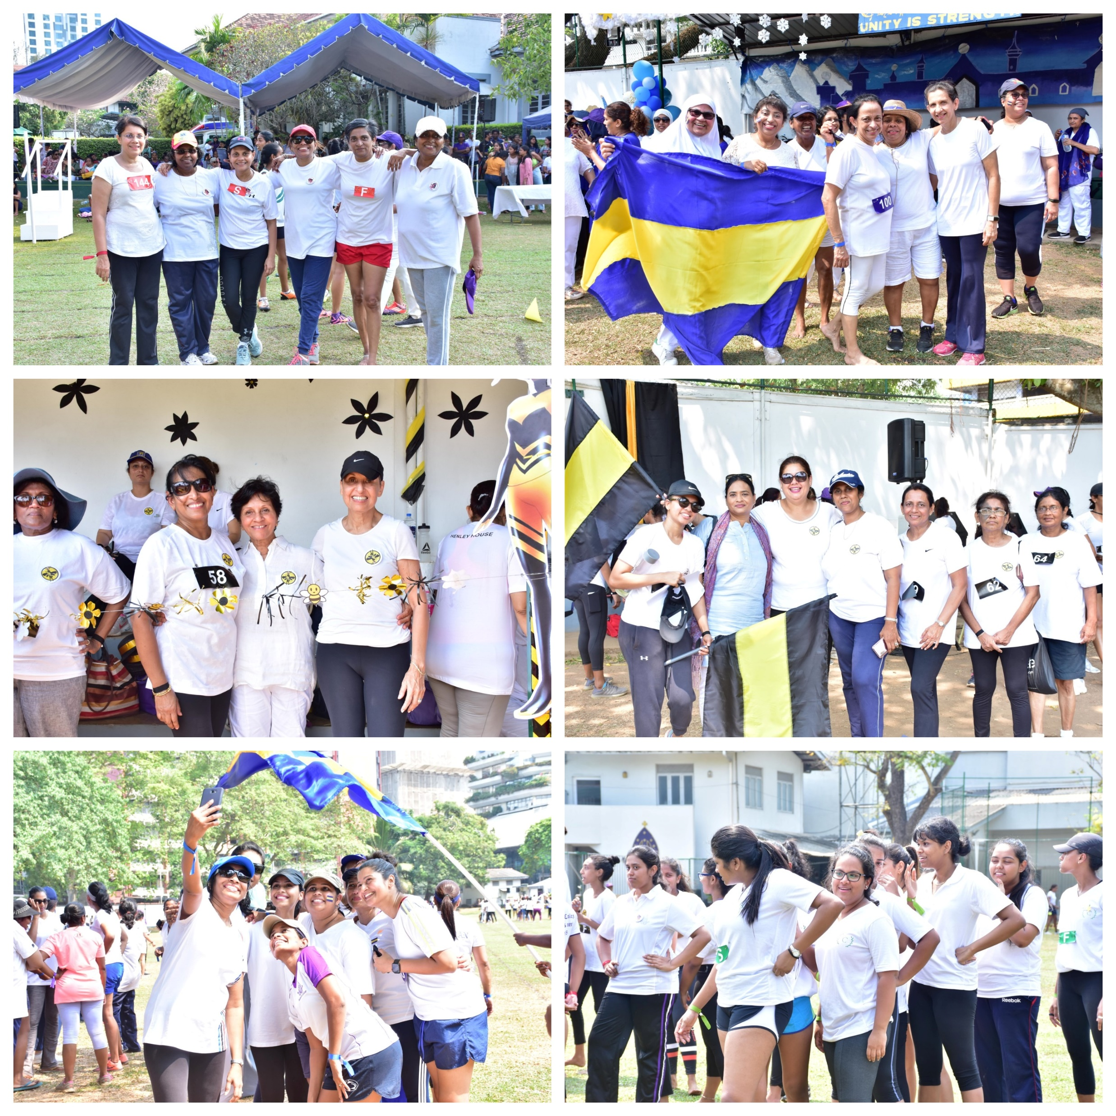

Slide 9
MARCH 2020
COVID 19

Slide 10
“You should never view your challenges as a disadvantage. Instead, its important for you to understand that your experience facing and overcoming adversity is actually one of your biggest advantages.”
MICHELLE OBAMA

Slide 11
We didn’t let the pandemic stop us……

Slide 12
Bishopians from across the world rallied to lend a helping hand

Slide 13
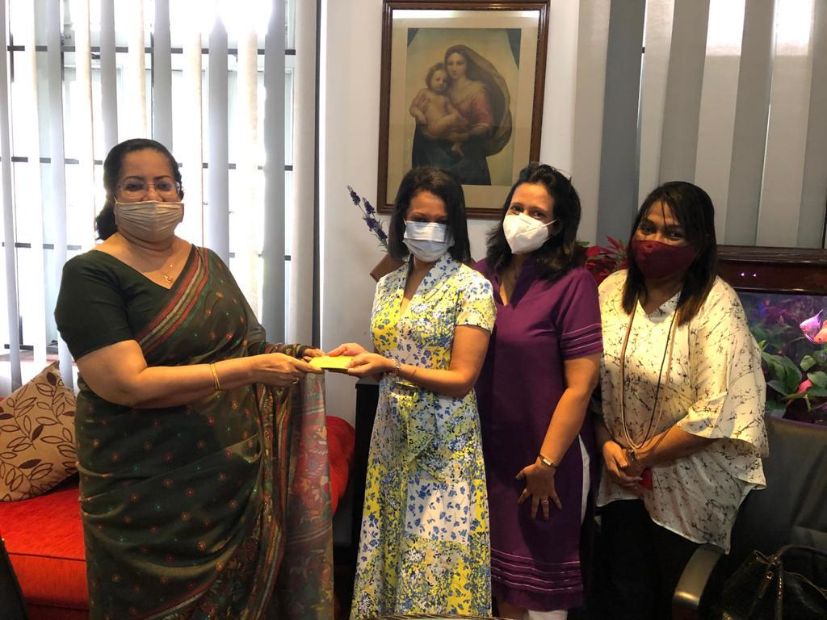
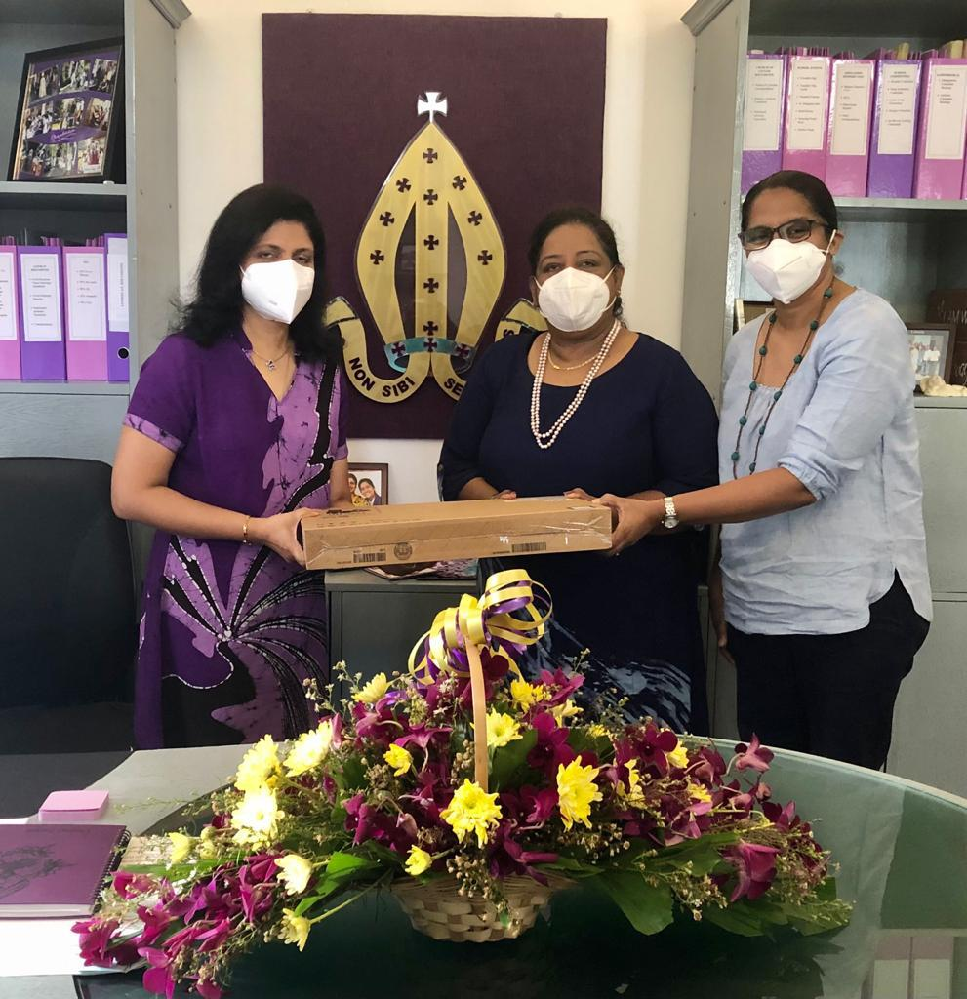
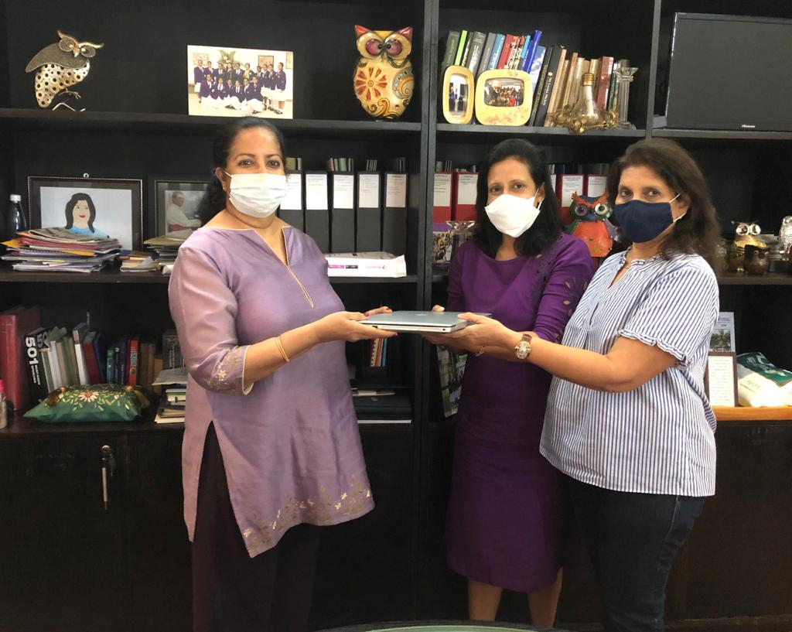
Sponsorship of school fees/scholarships for 52 students

Slide 14
Sponsorship of 28 brand new laptops/smart devices

Slide 15
Together we raised over Rs 9 Mn in donations

Slide 16
In 2022
Fund Raising for BC PPA 125th Anniversary began…

Slide 17
PPA Organized the GRAND FINALE of DWANI 2022
The “Festival of Dance & Drums” by the Oriental Dance Society of Bishop’s College

Slide 18
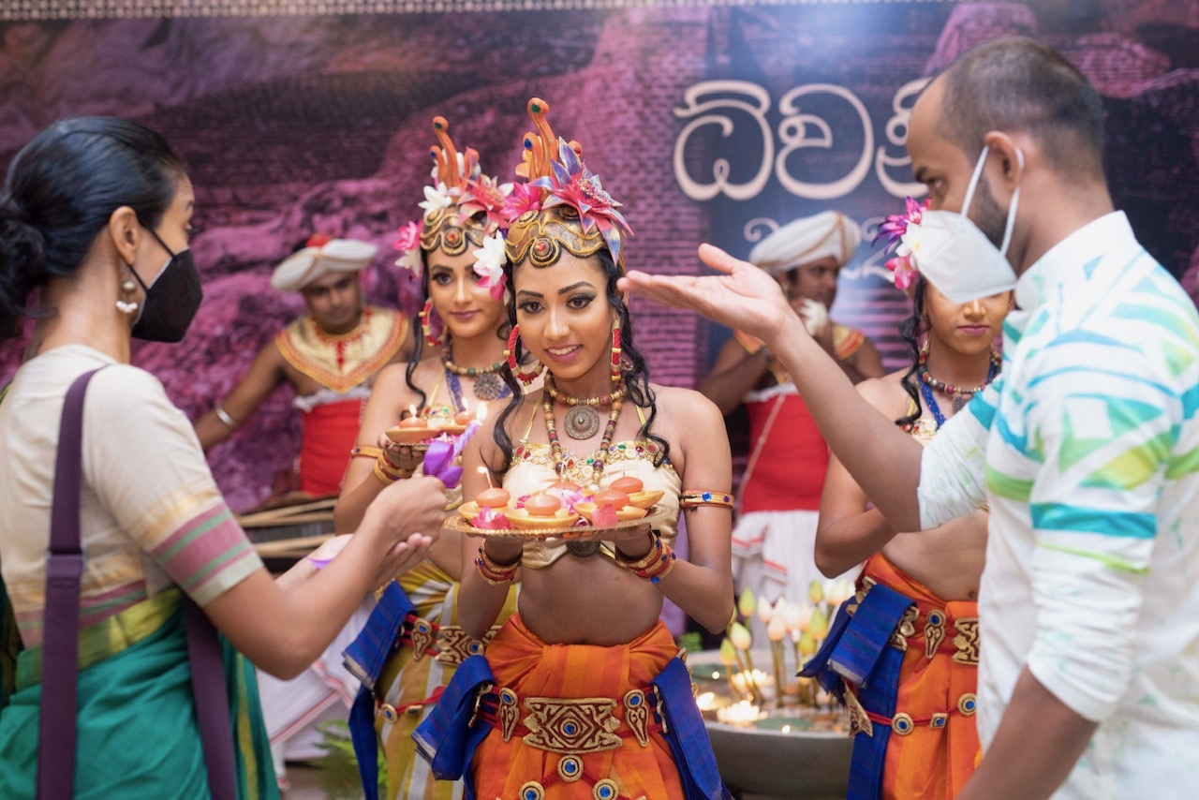

Slide 20
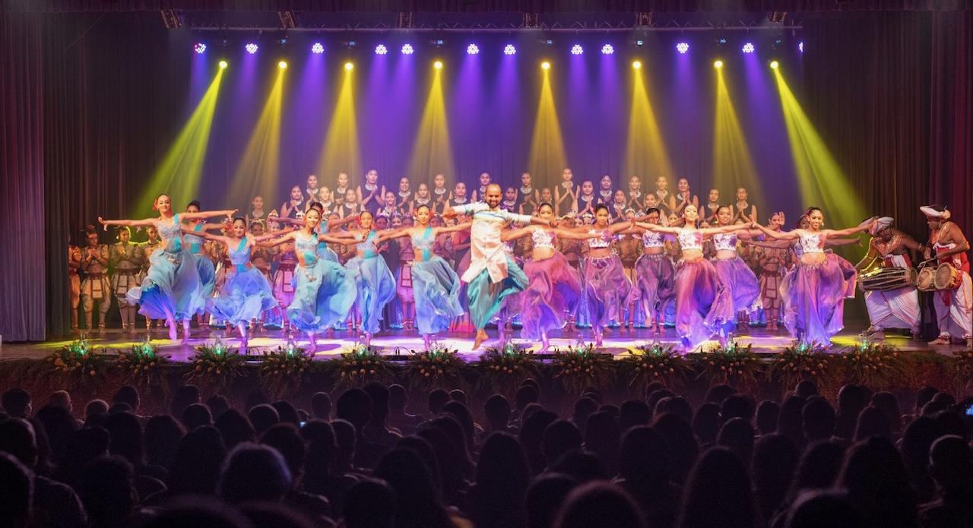

Slide 21
On 3rd September 2022
we celebrated the 125th Anniversary of the
Bishop’s College PPA

Slide 22
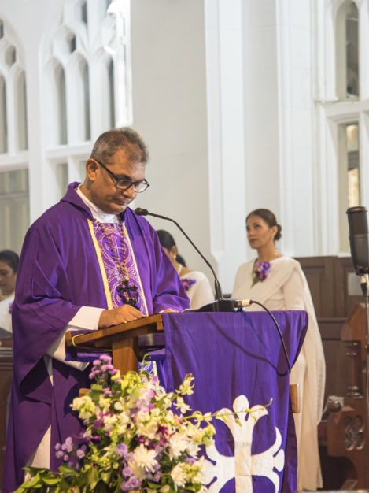
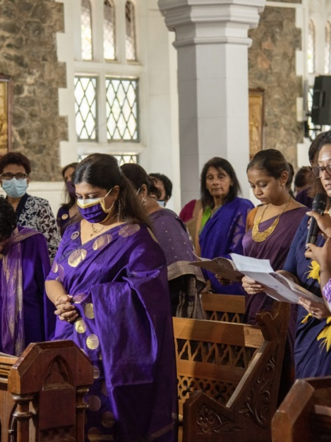
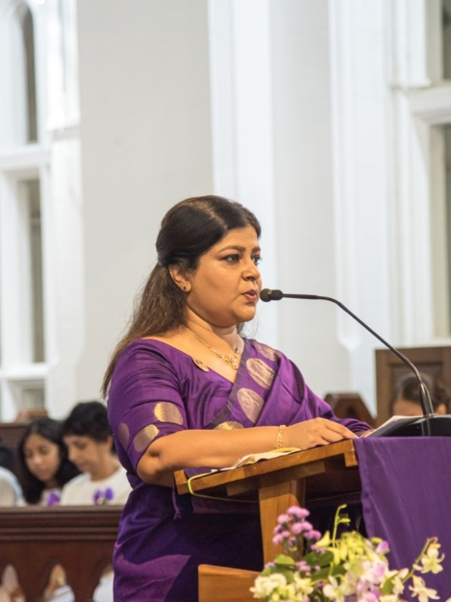
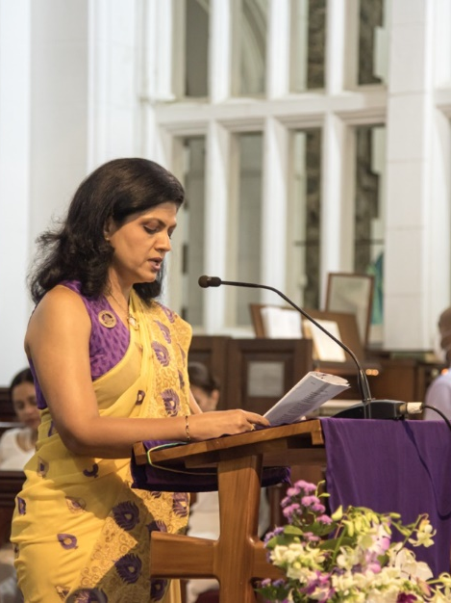
Anniversary Service & Celebrations

Slide 23
Anniversary Service & Celebrations

Slide 24
Anniversary Service & Celebrations

Slide 25
Anniversary Service & Celebrations

Slide 26
Anniversary Service & Celebrations

Slide 27
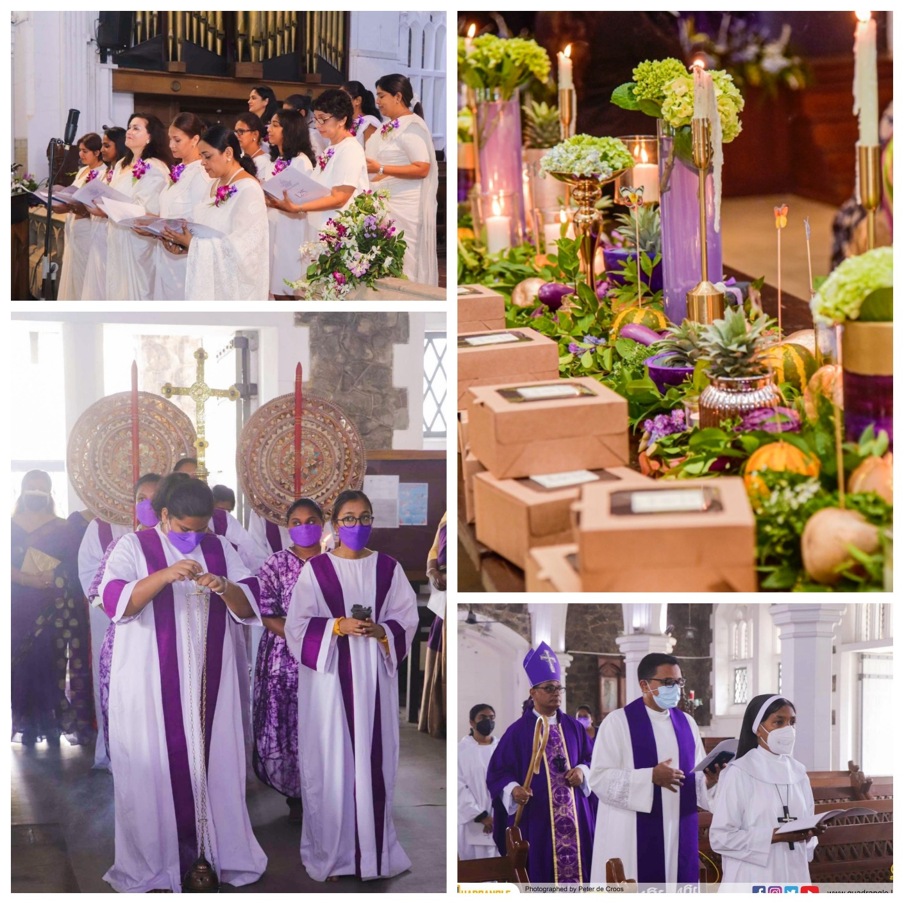
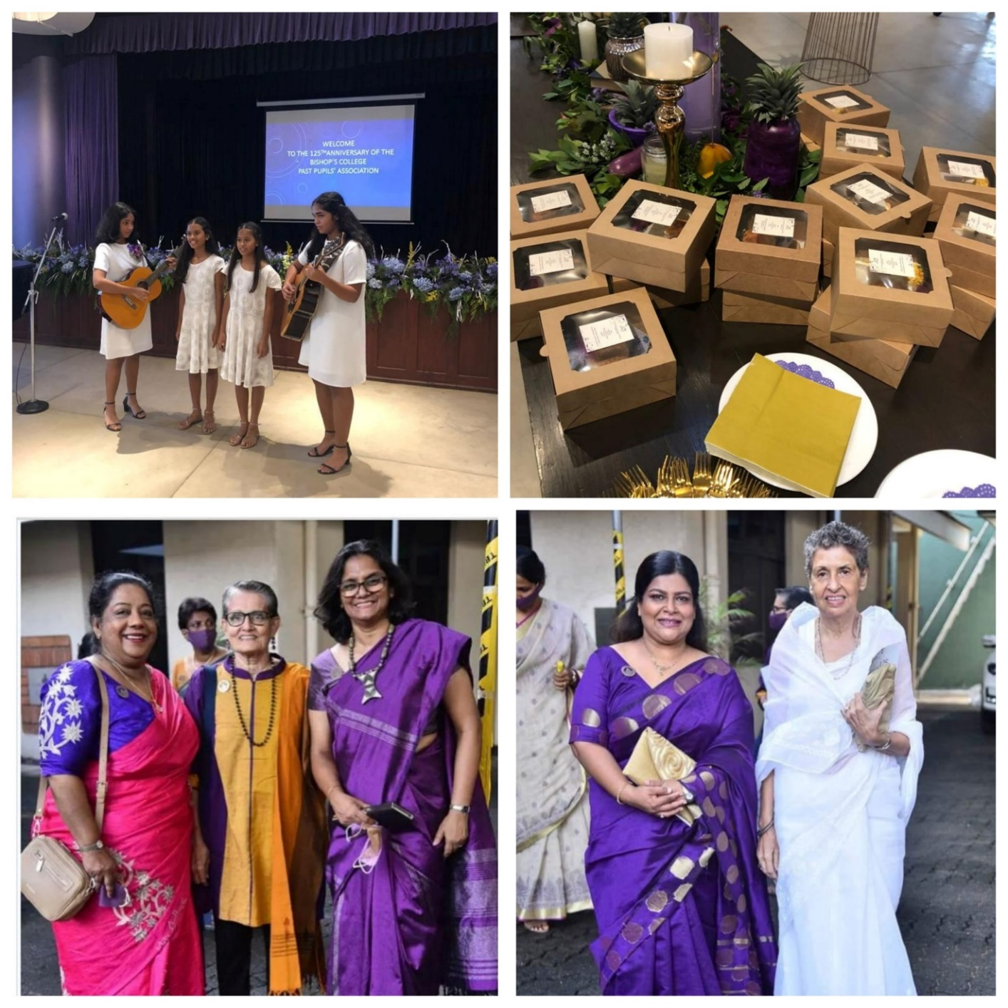
Anniversary Service & Celebrations

Slide 28
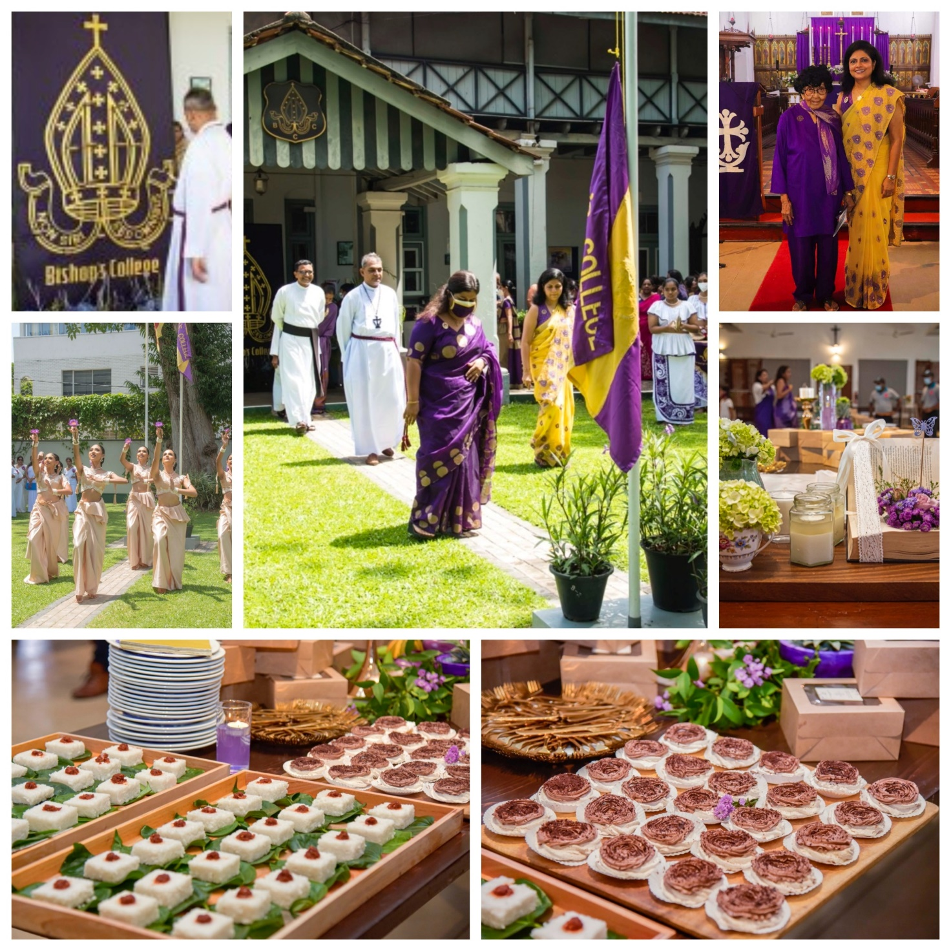
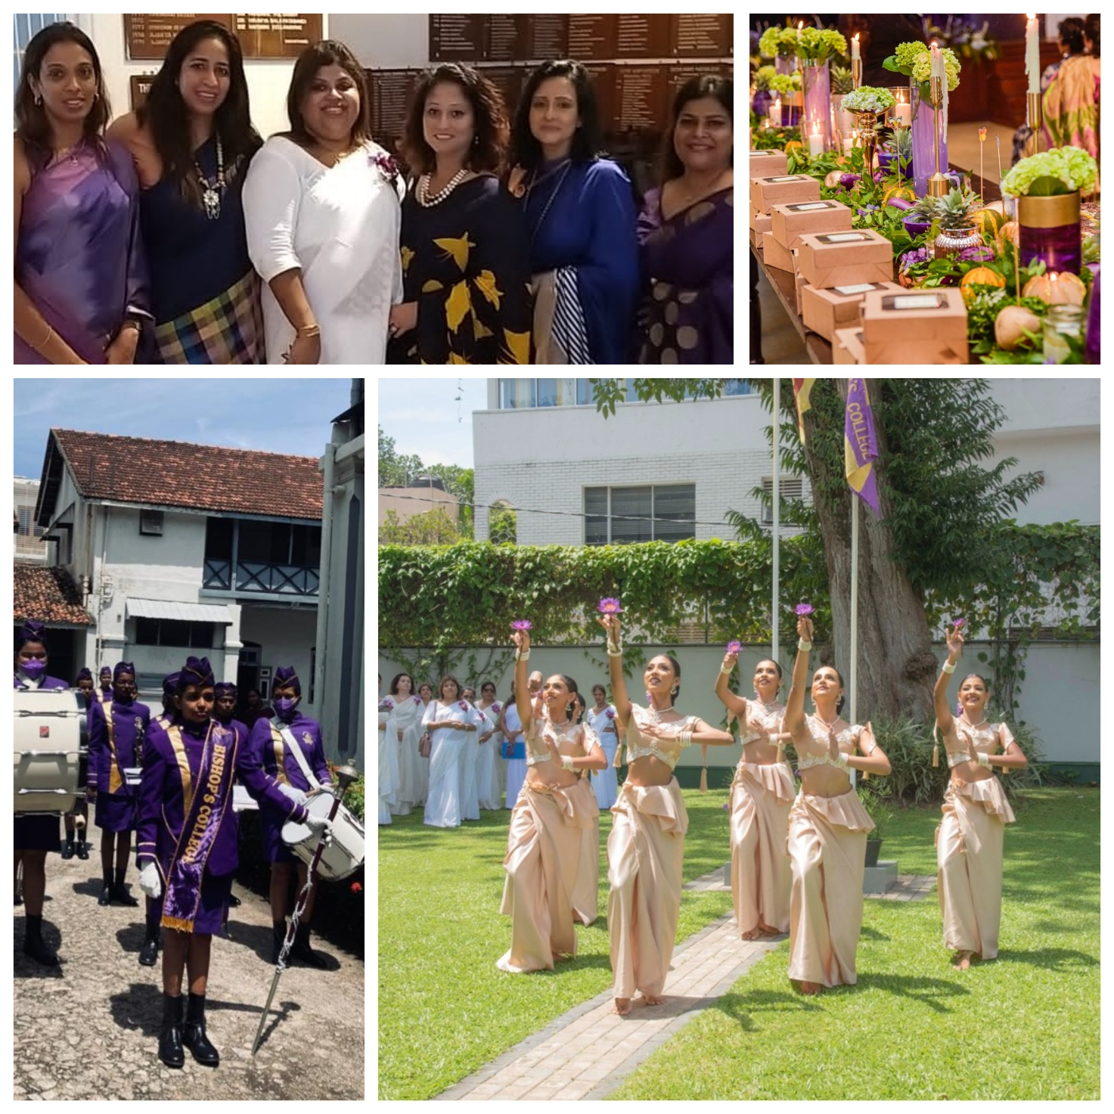
Anniversary Service & Celebrations

Slide 29
Much Awaited Christmas Party after
3 years

Slide 30
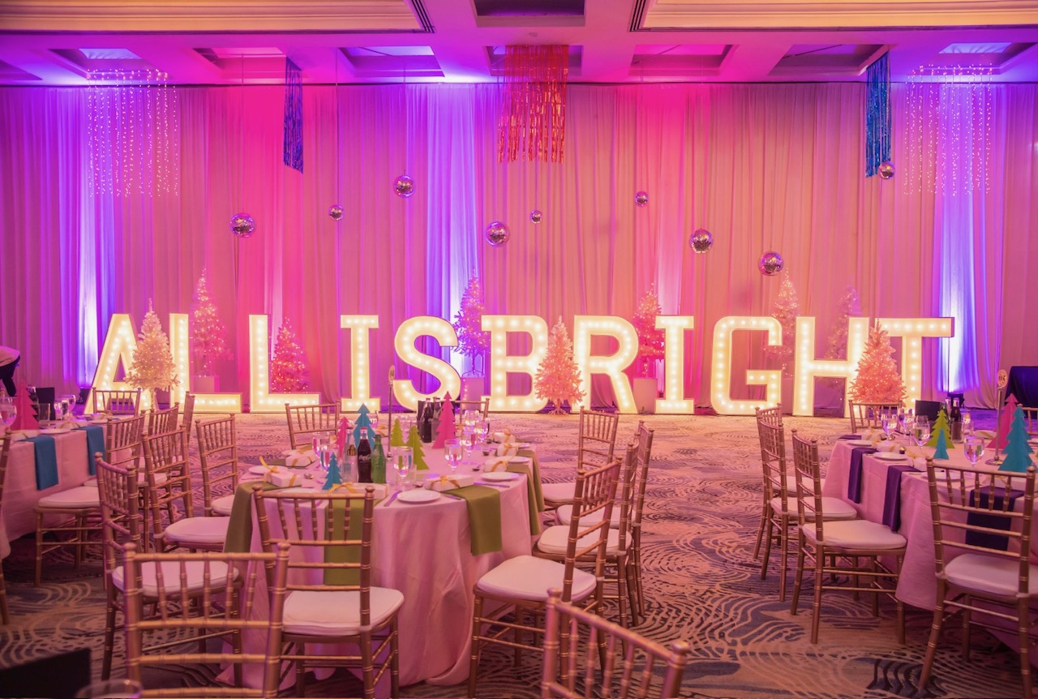

Slide 31
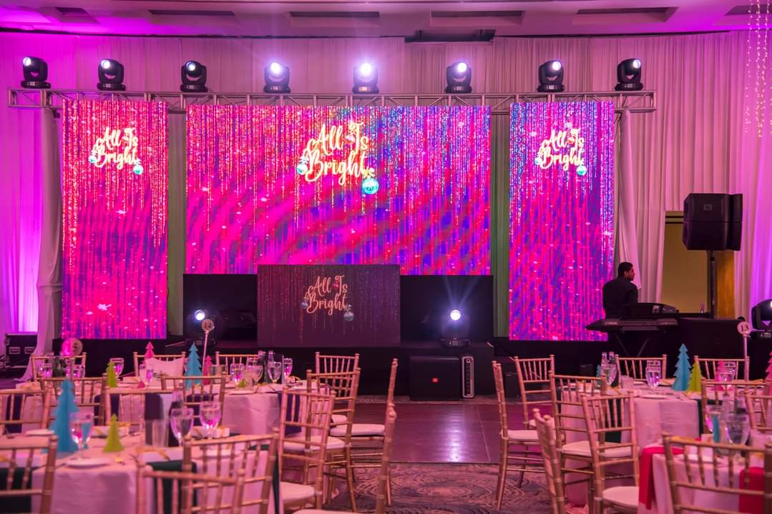

Slide 32
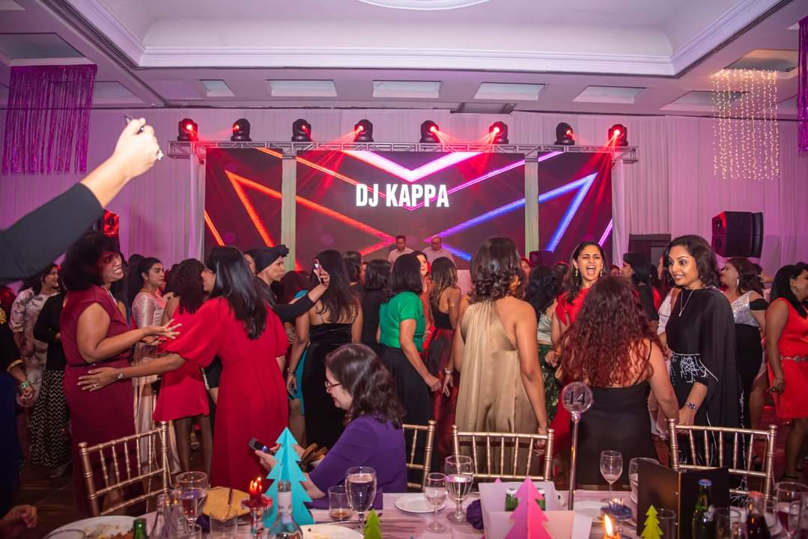
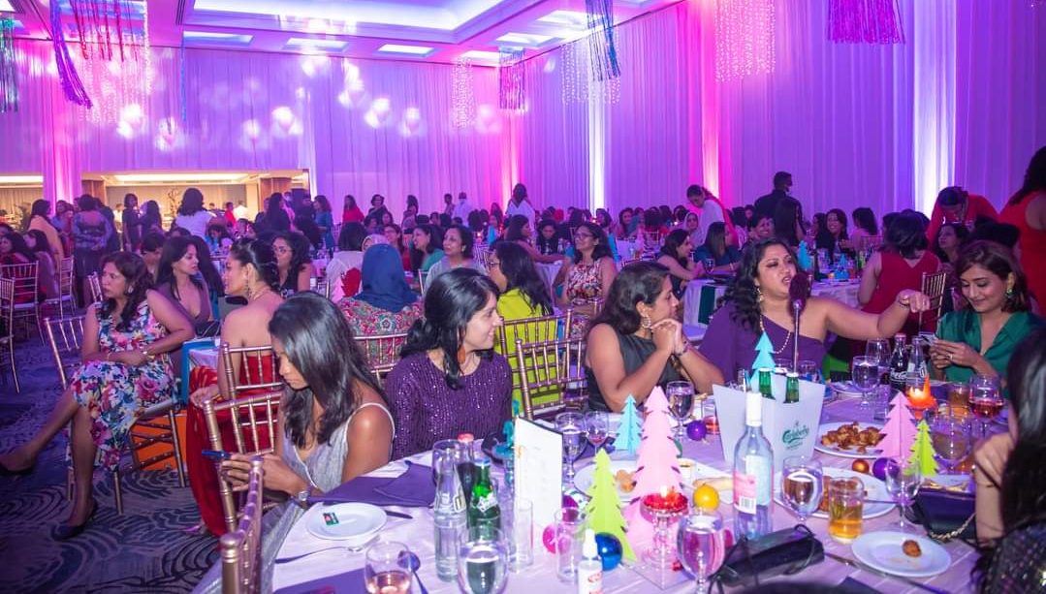

Slide 33
Even amidst your busy schedules you didn’t forget to represent our beloved alma mater

Slide 34
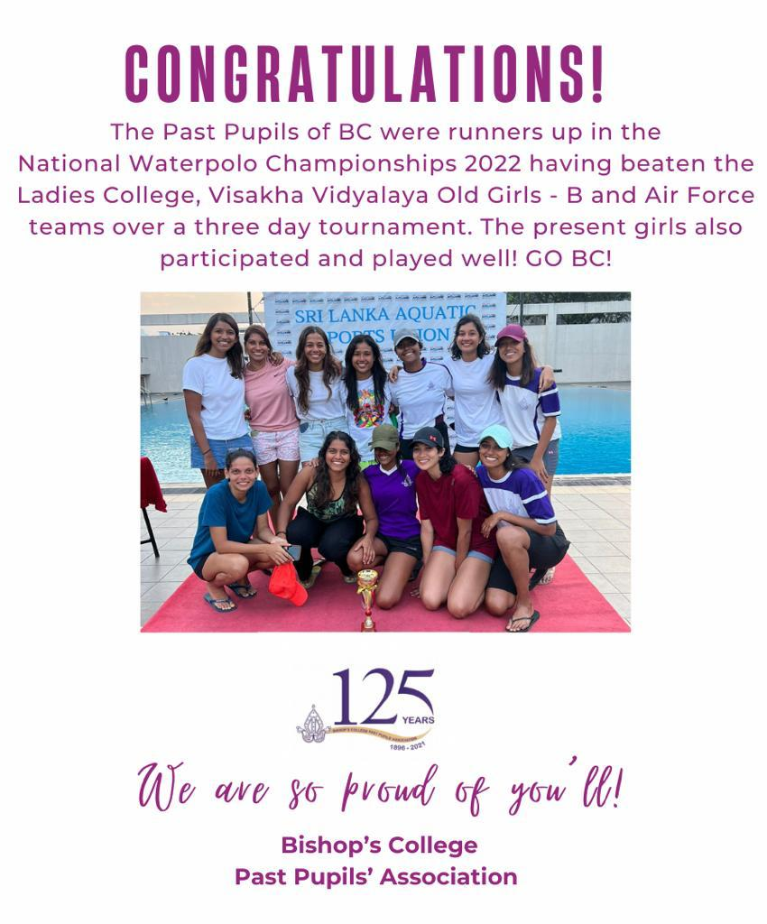
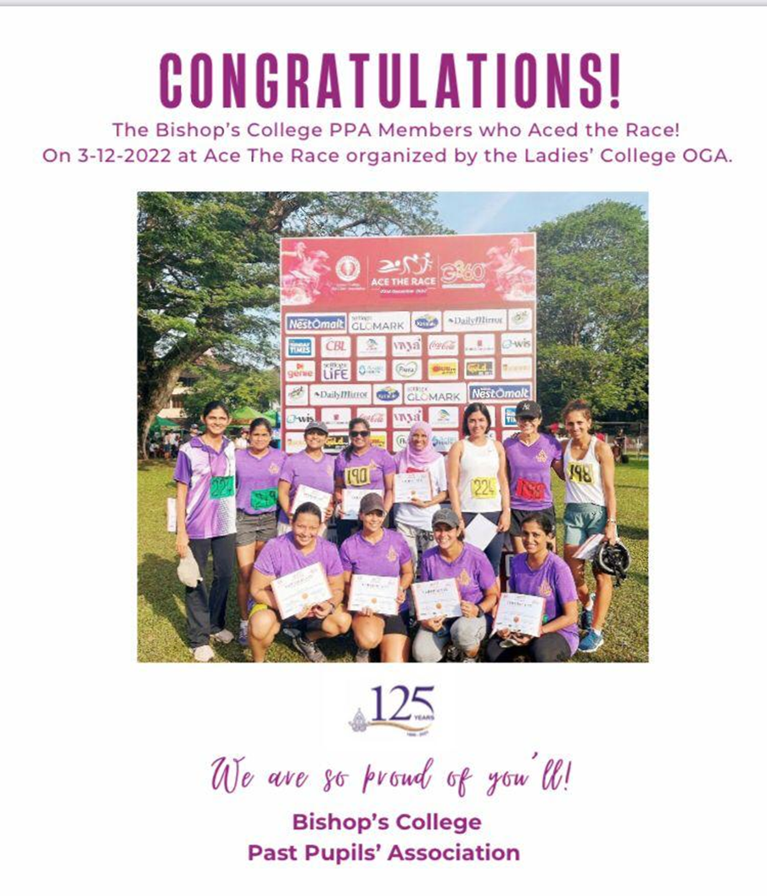

Slide 36
125th Anniversary Celebration 2022

Slide 37
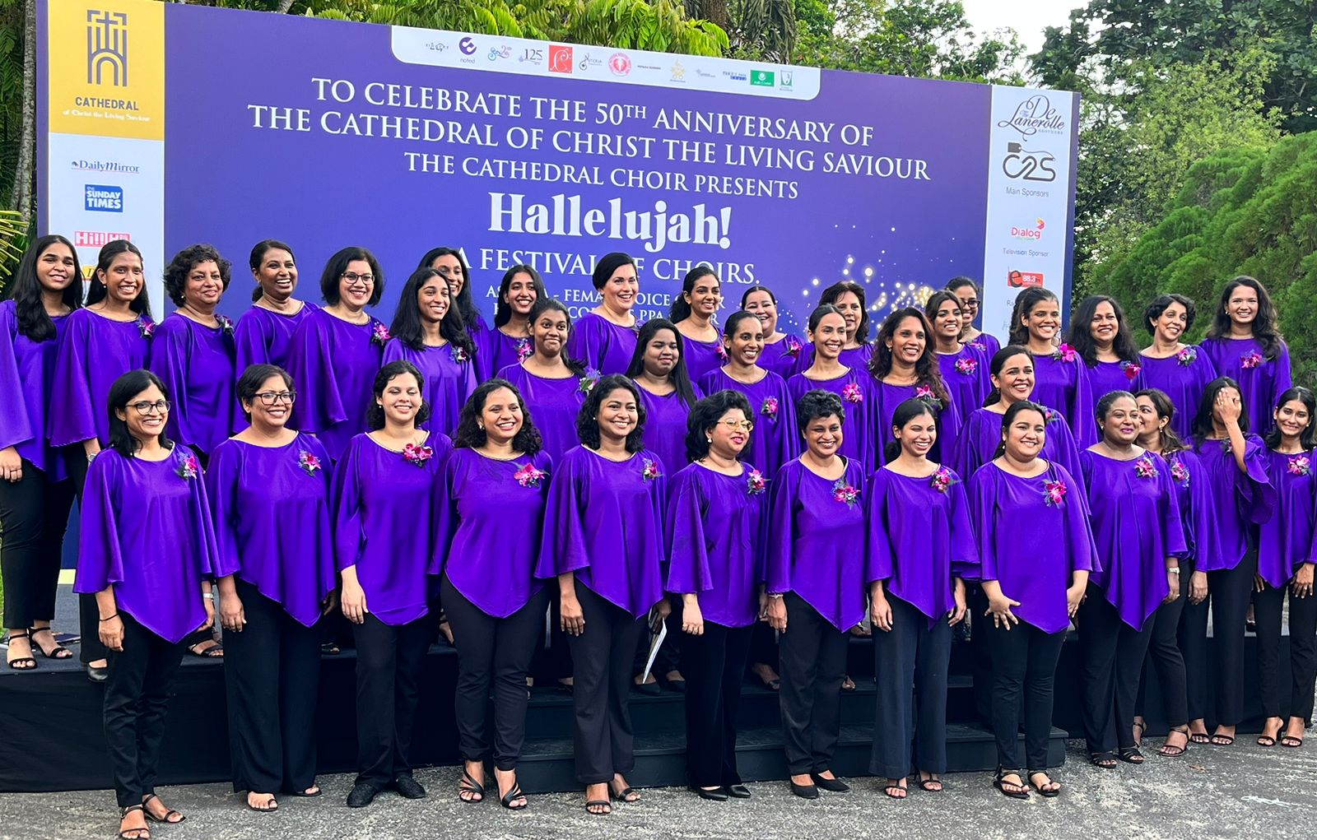
Festival of Choirs 2023

Slide 38
A heartfelt thank you to everyone who participated!!

Slide 39
We continued to live up to our motto
“NON SIBI SED OMNIBUS”
and give back to the community

Slide 40
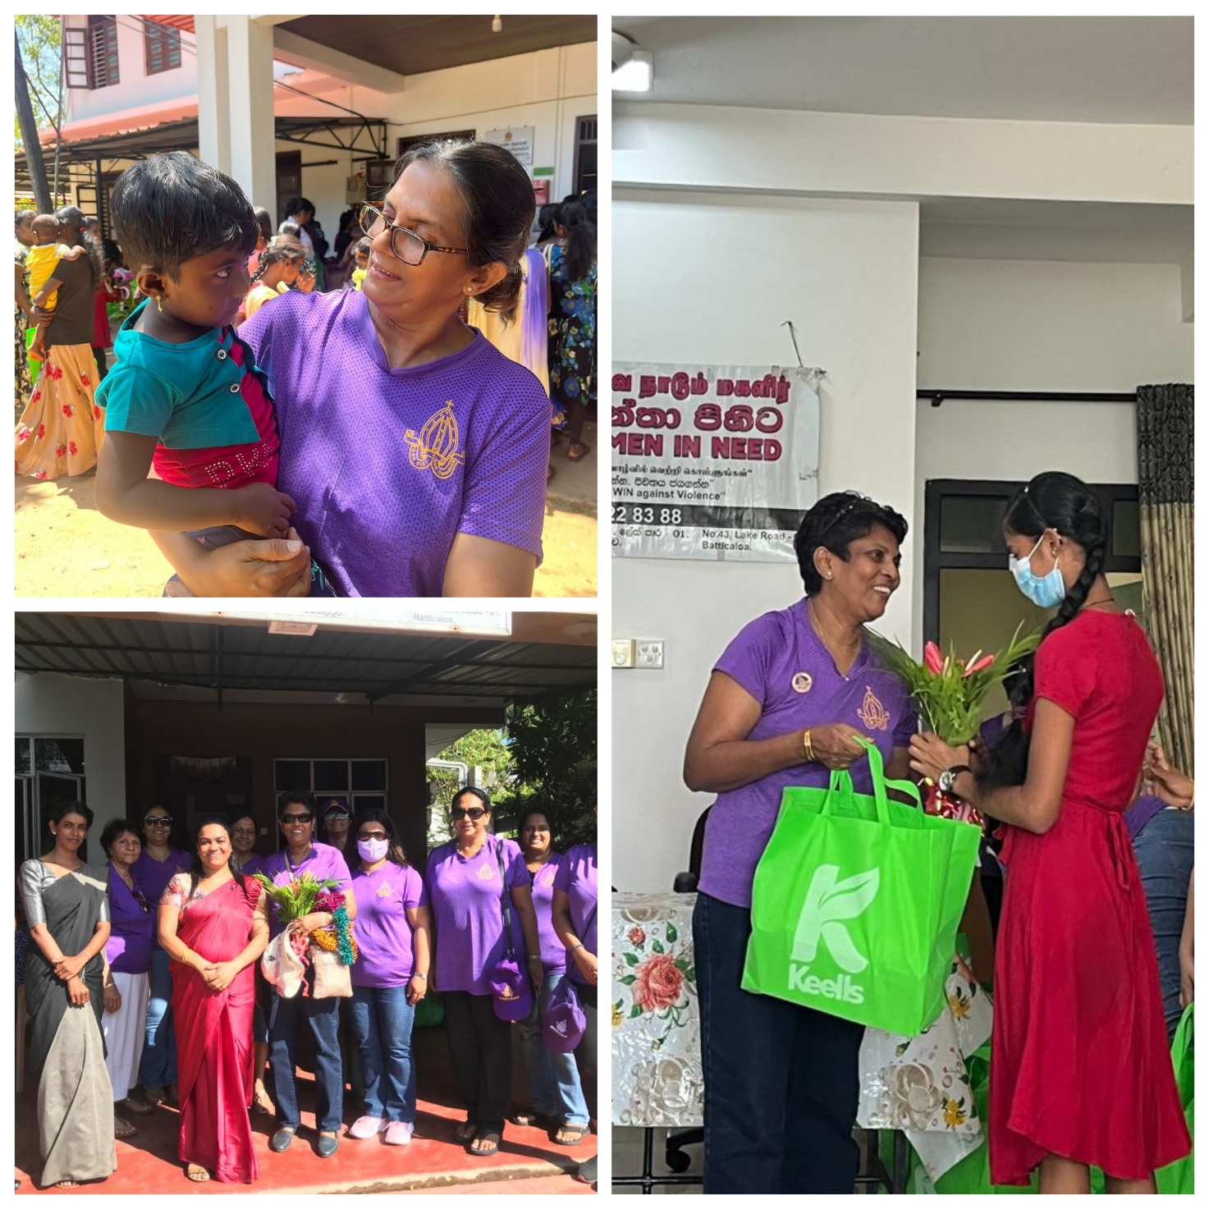
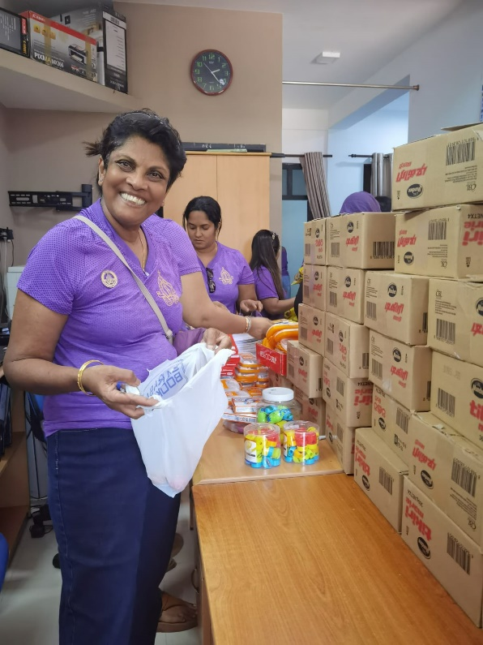
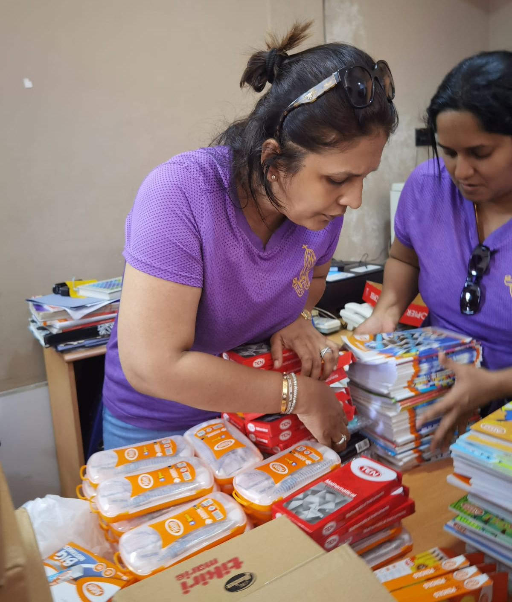
All Is Bright Christmas Charity Project
School shoes & supplies for 100 under privileged school children at Women In Need shelter - Batticaloa

Slide 41
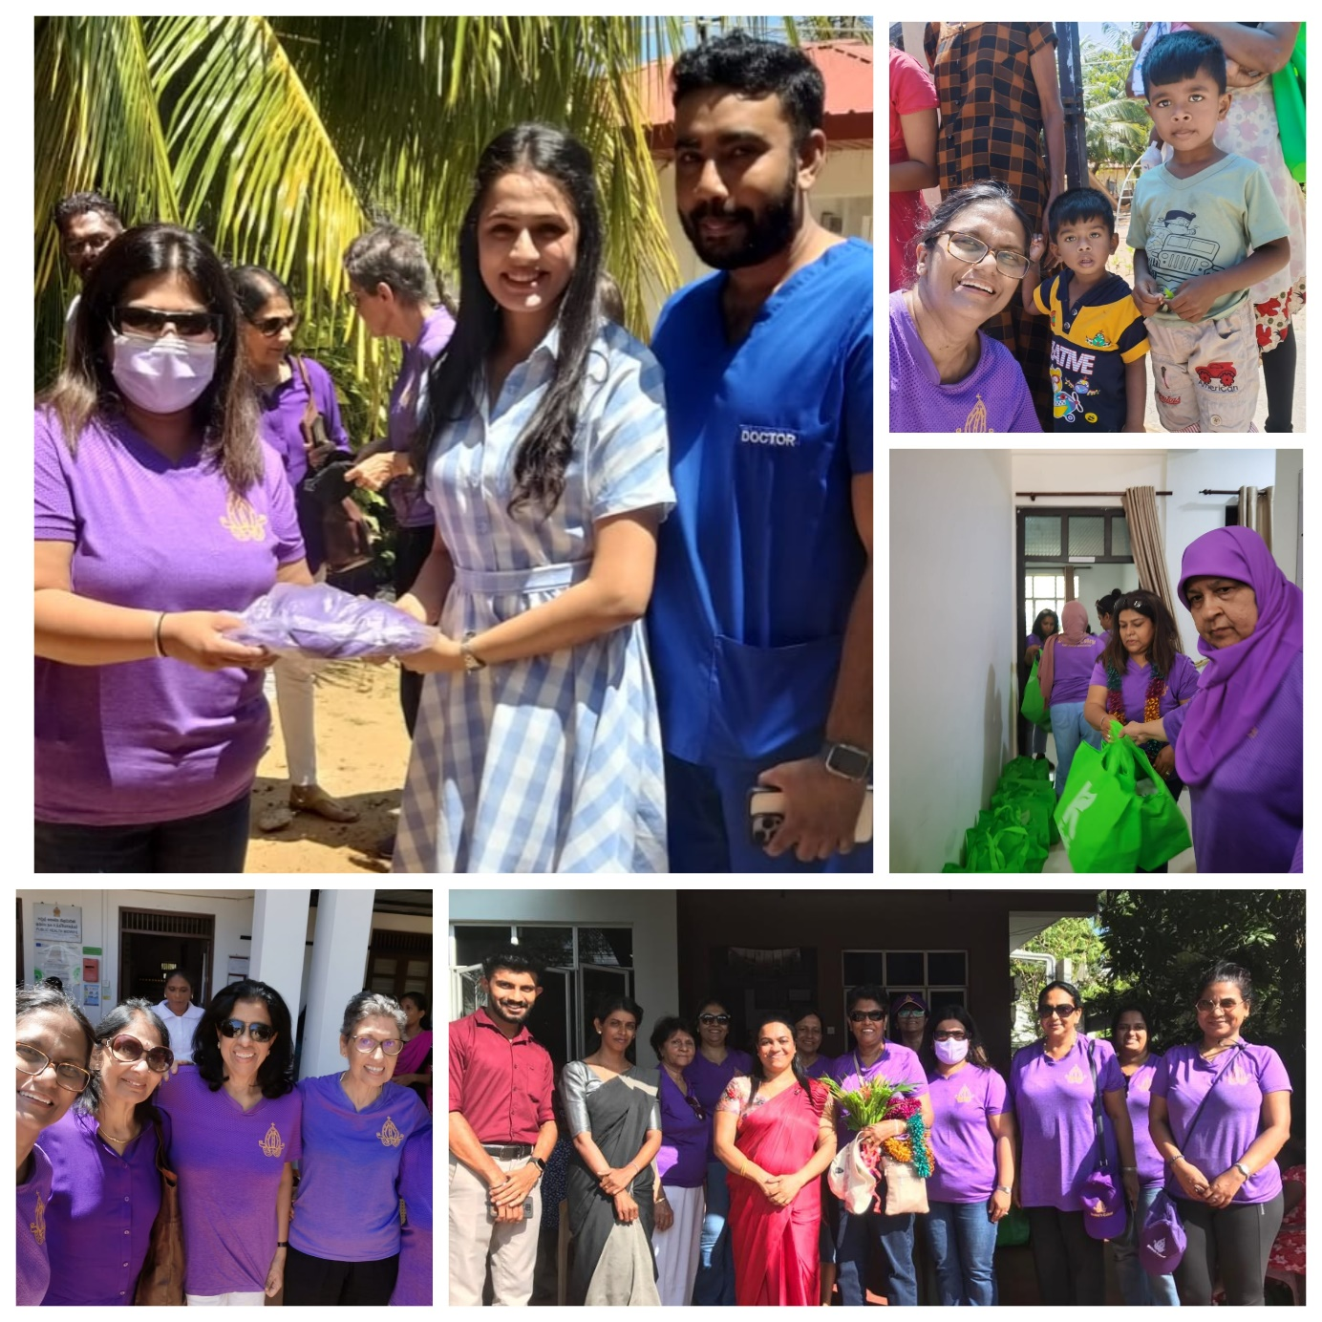
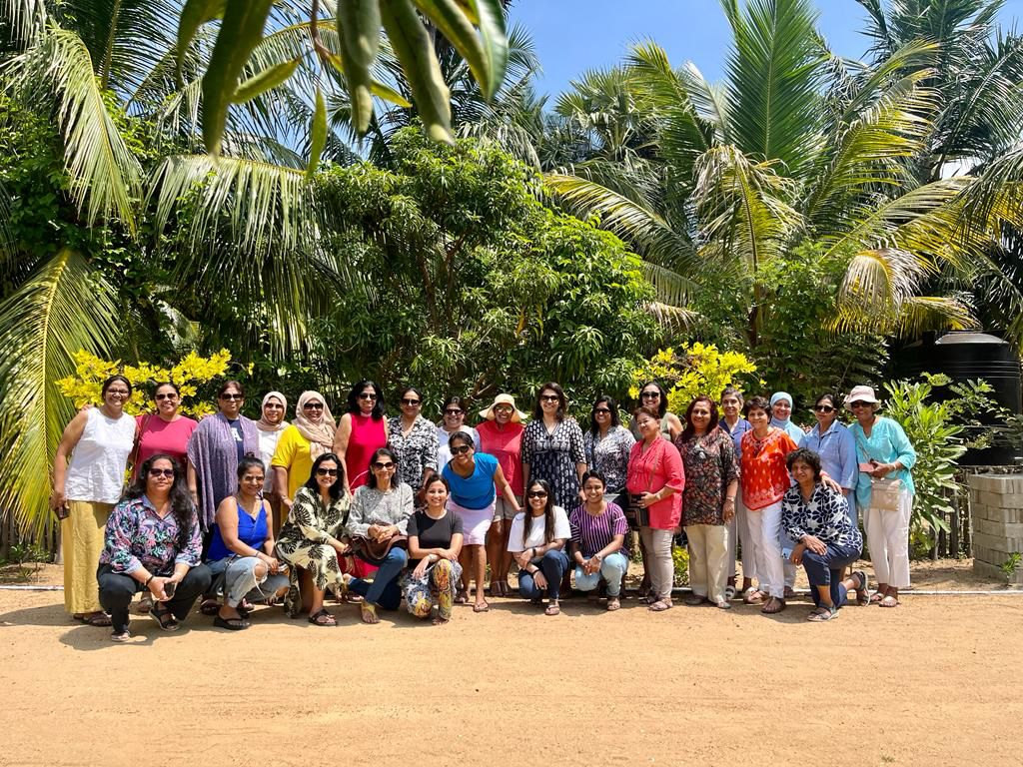
All Is Bright Christmas Charity Project
Organizing Committee
Nutritional packs for 150 under privileged pregnant mothers through MOH Office Vaharai

Slide 42
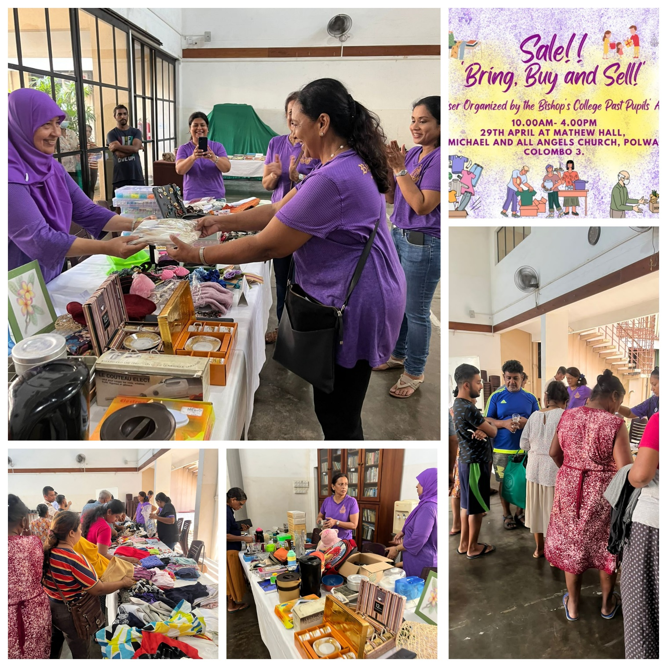
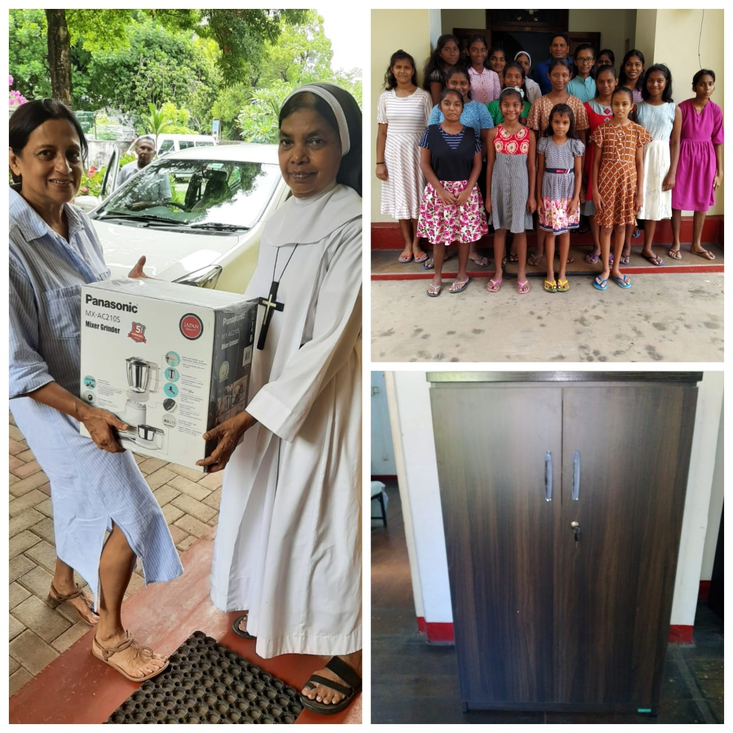
Bring, Buy and Sell Sale 2023
Handing over donations from the proceeds

Slide 43
A collaboration between
BC PPA & Bishop’s College Oriental Dance Society

Slide 44
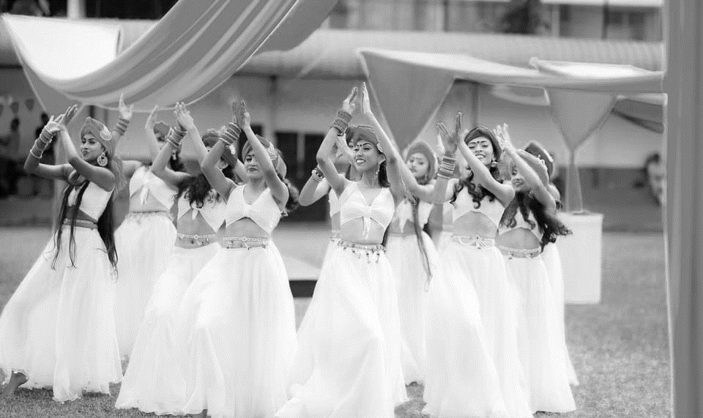

Slide 46
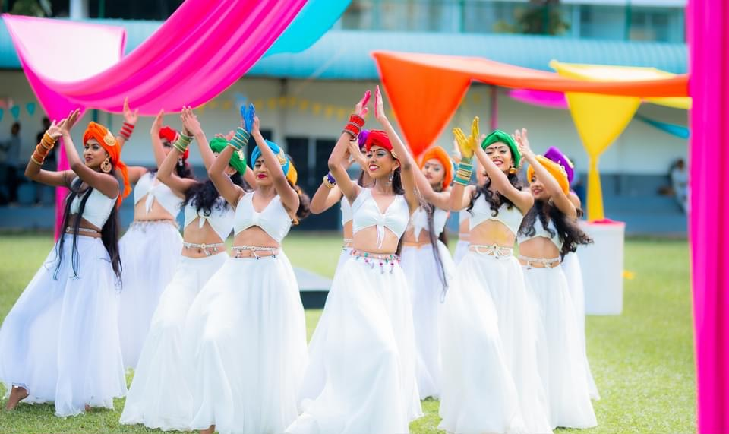

Slide 47
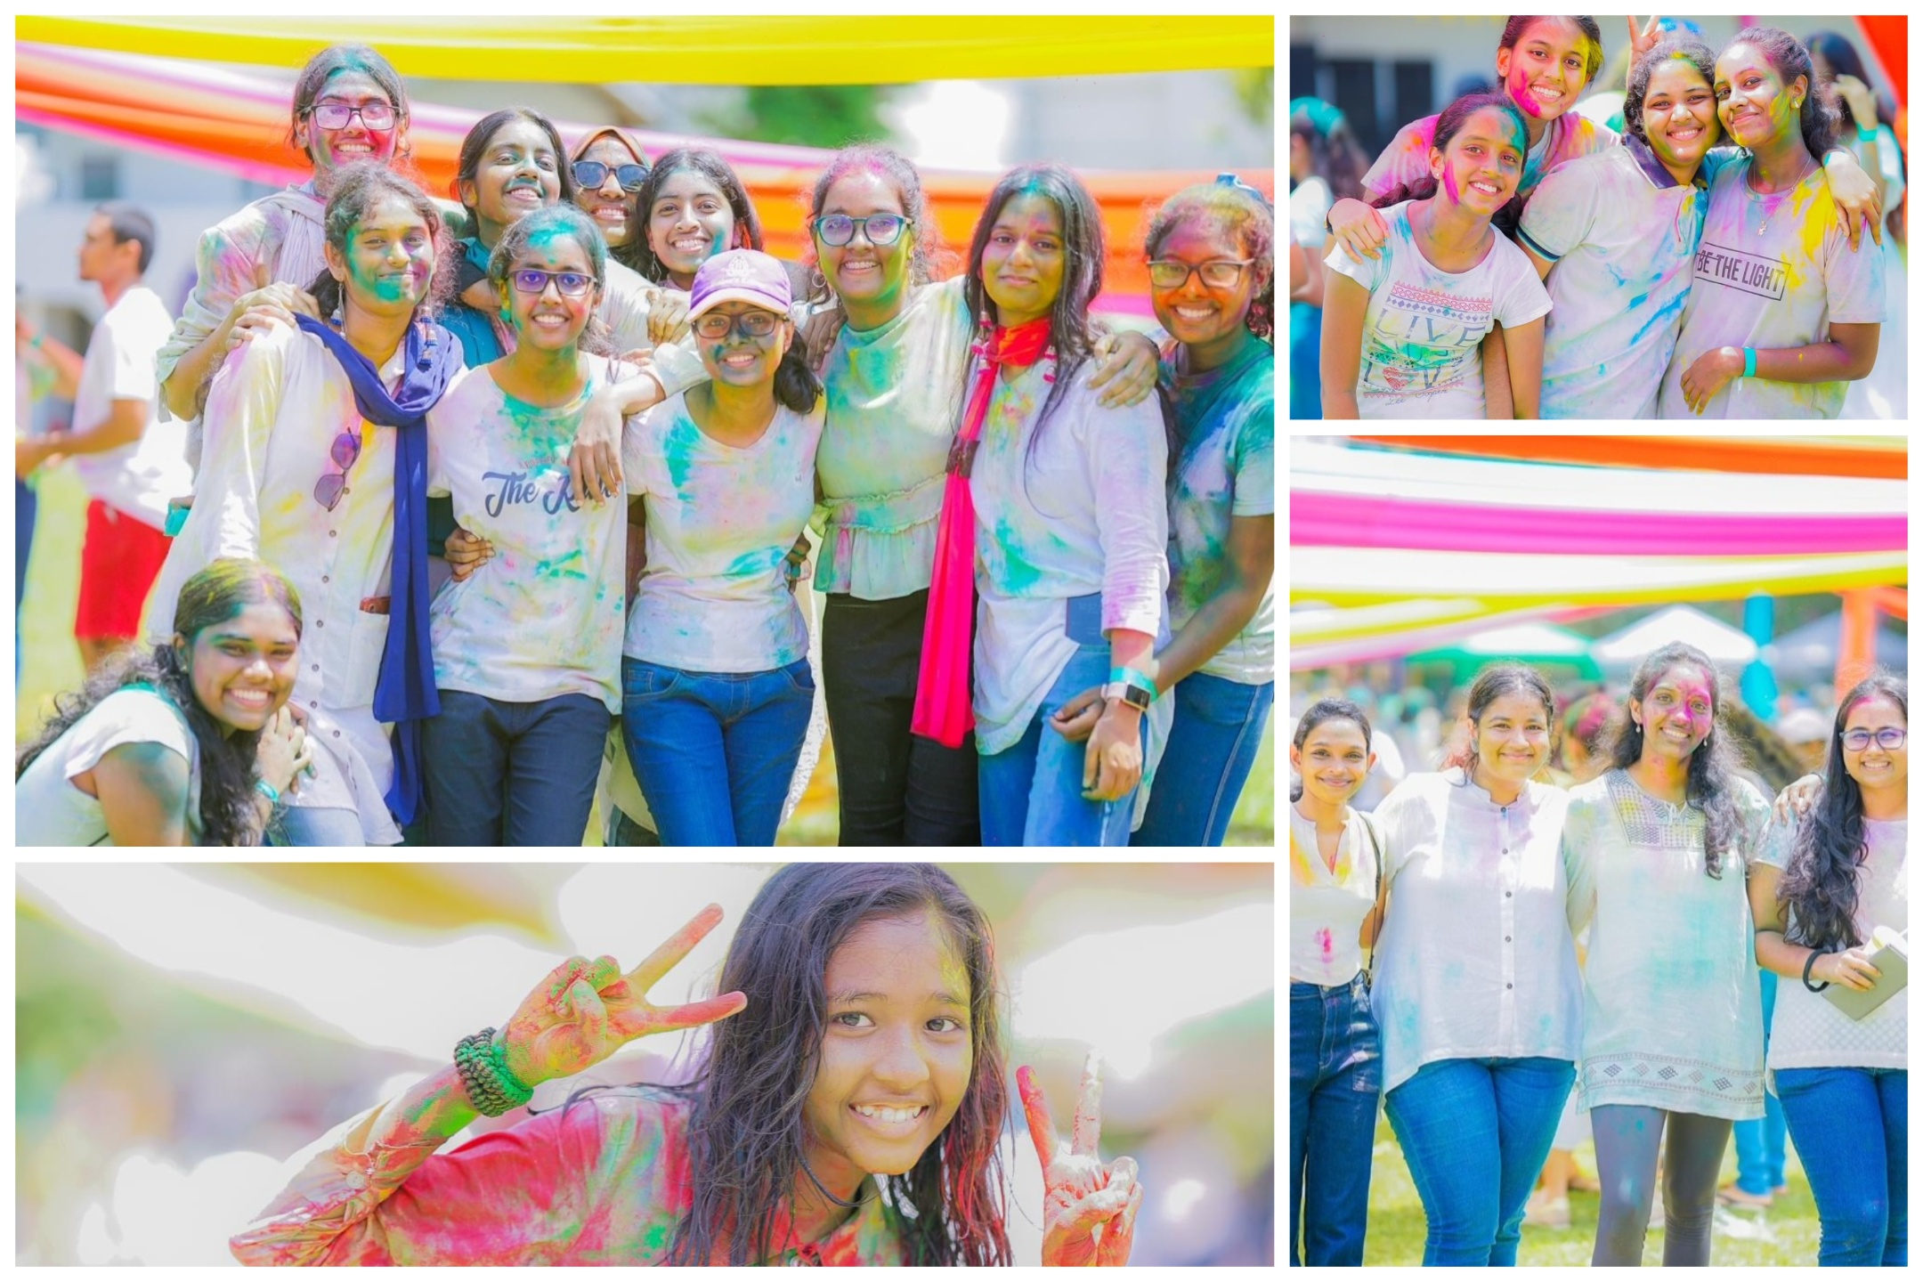
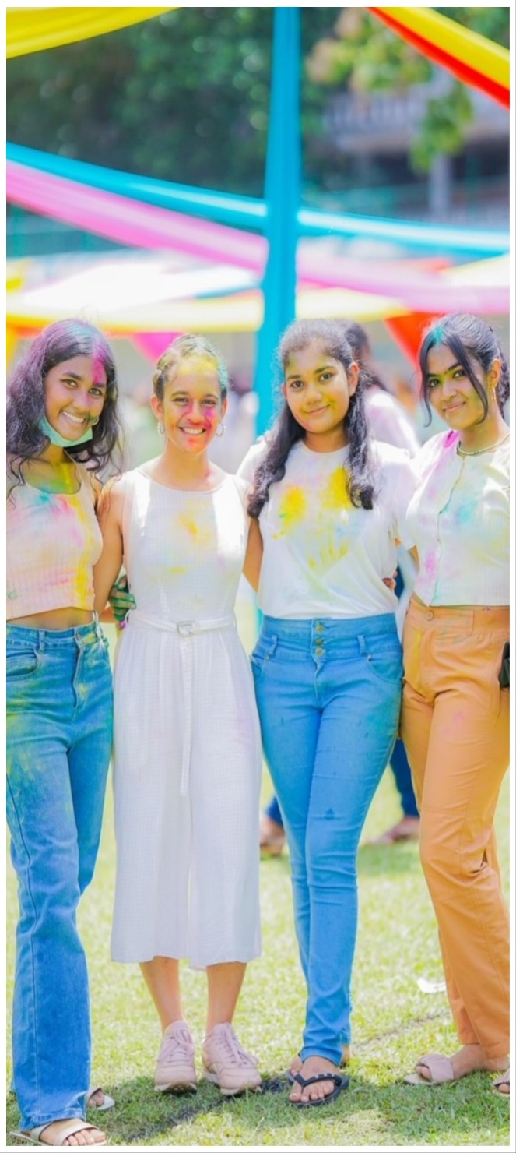
It was a colourful day filled with fun

Slide 48
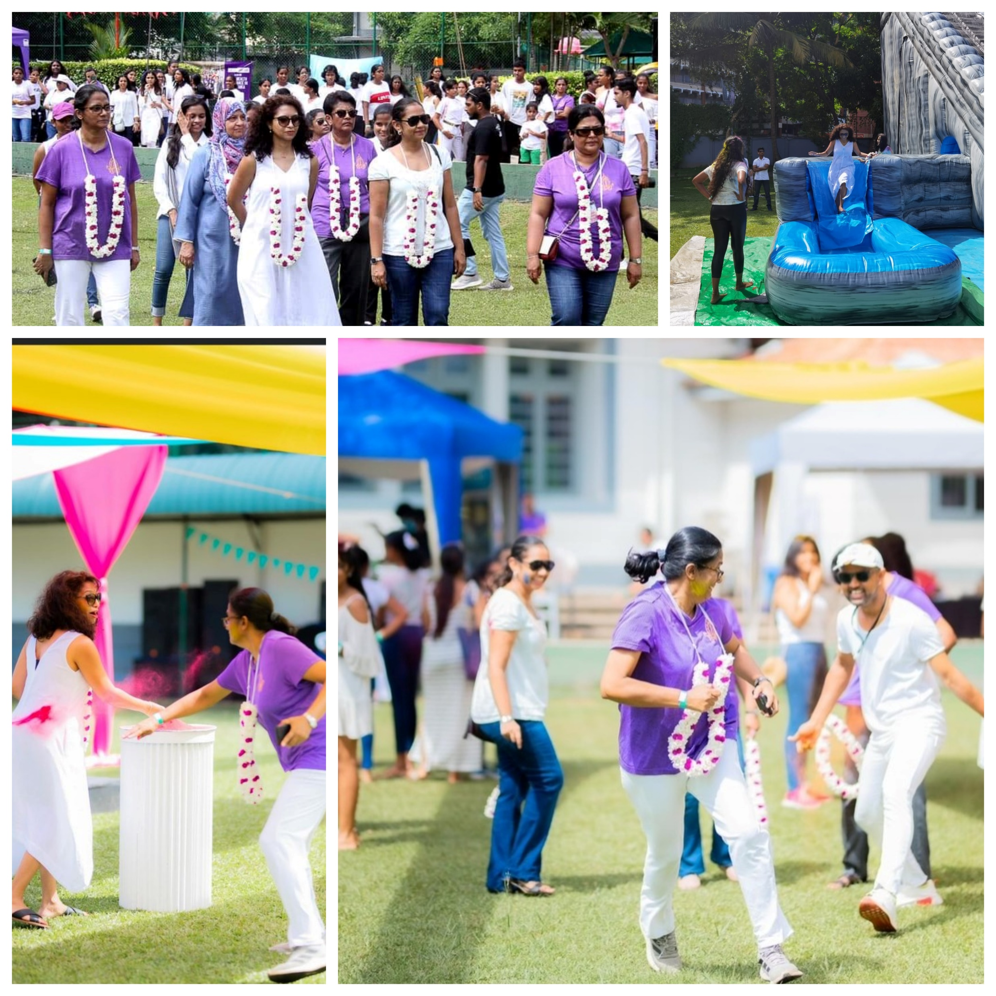
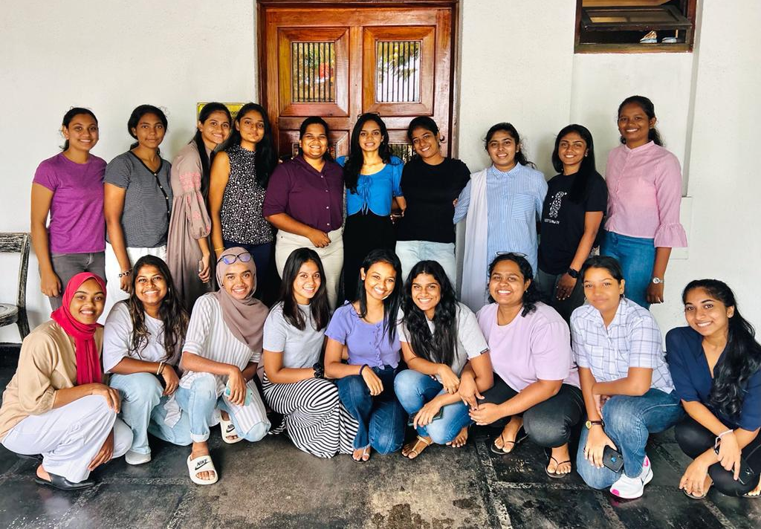
Amidst all the work we also had fun
Festival of Colours – Organizing Committee
Proceeds from this event will be directed towards funding equipment for the hewisi band and sick room renovation project

Slide 49
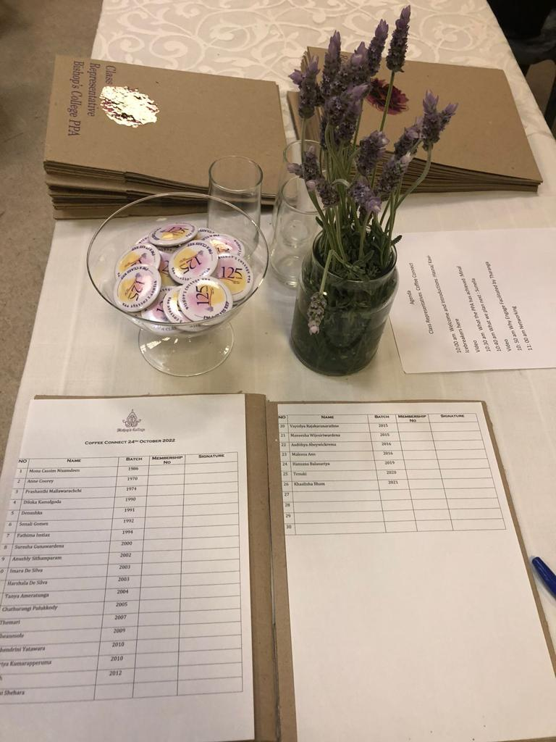
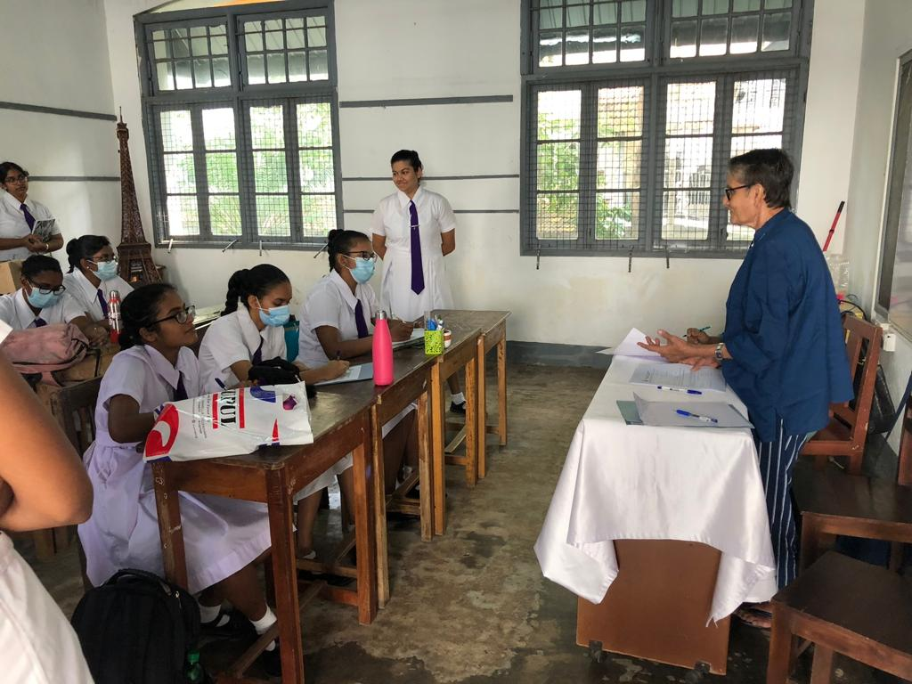
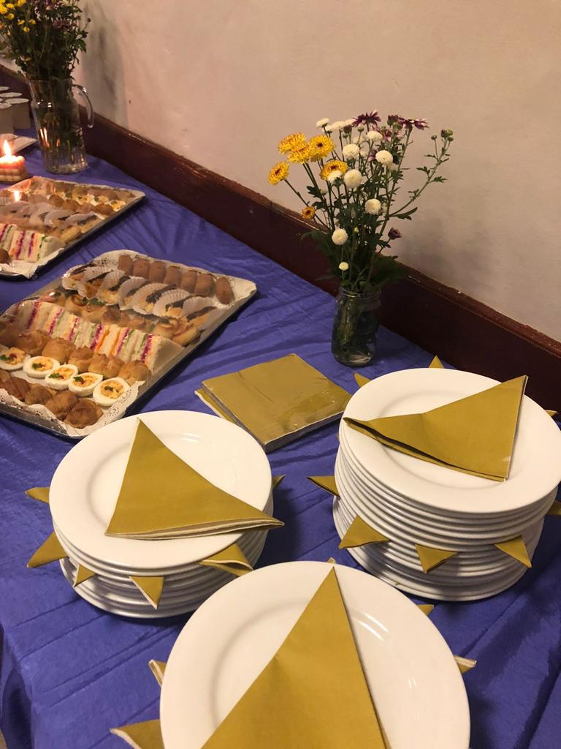
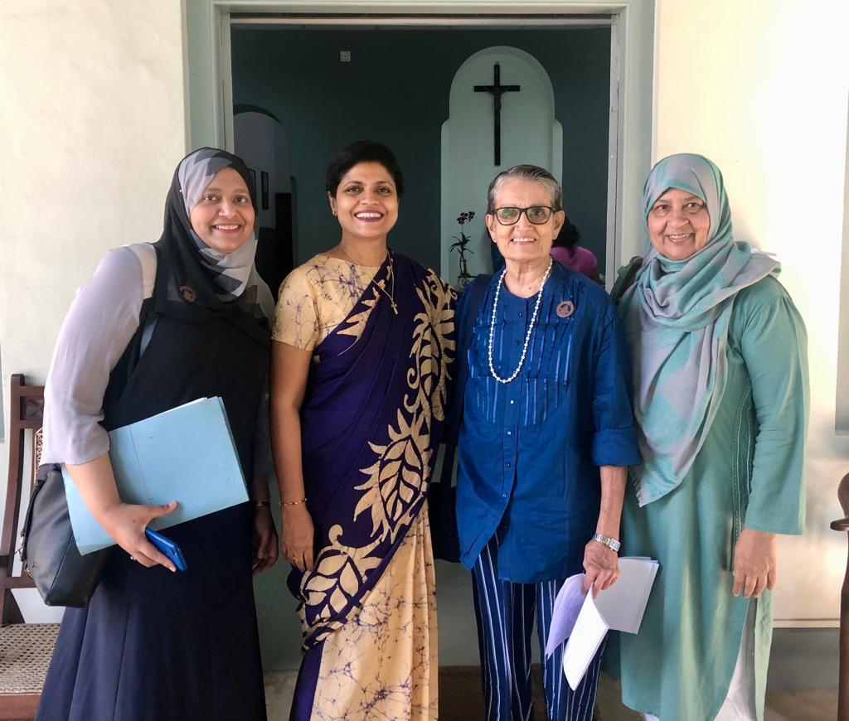
Amidst all these projects we also continued our traditions
Class Reps
Coffee Connect
Membership
Drive

Slide 50
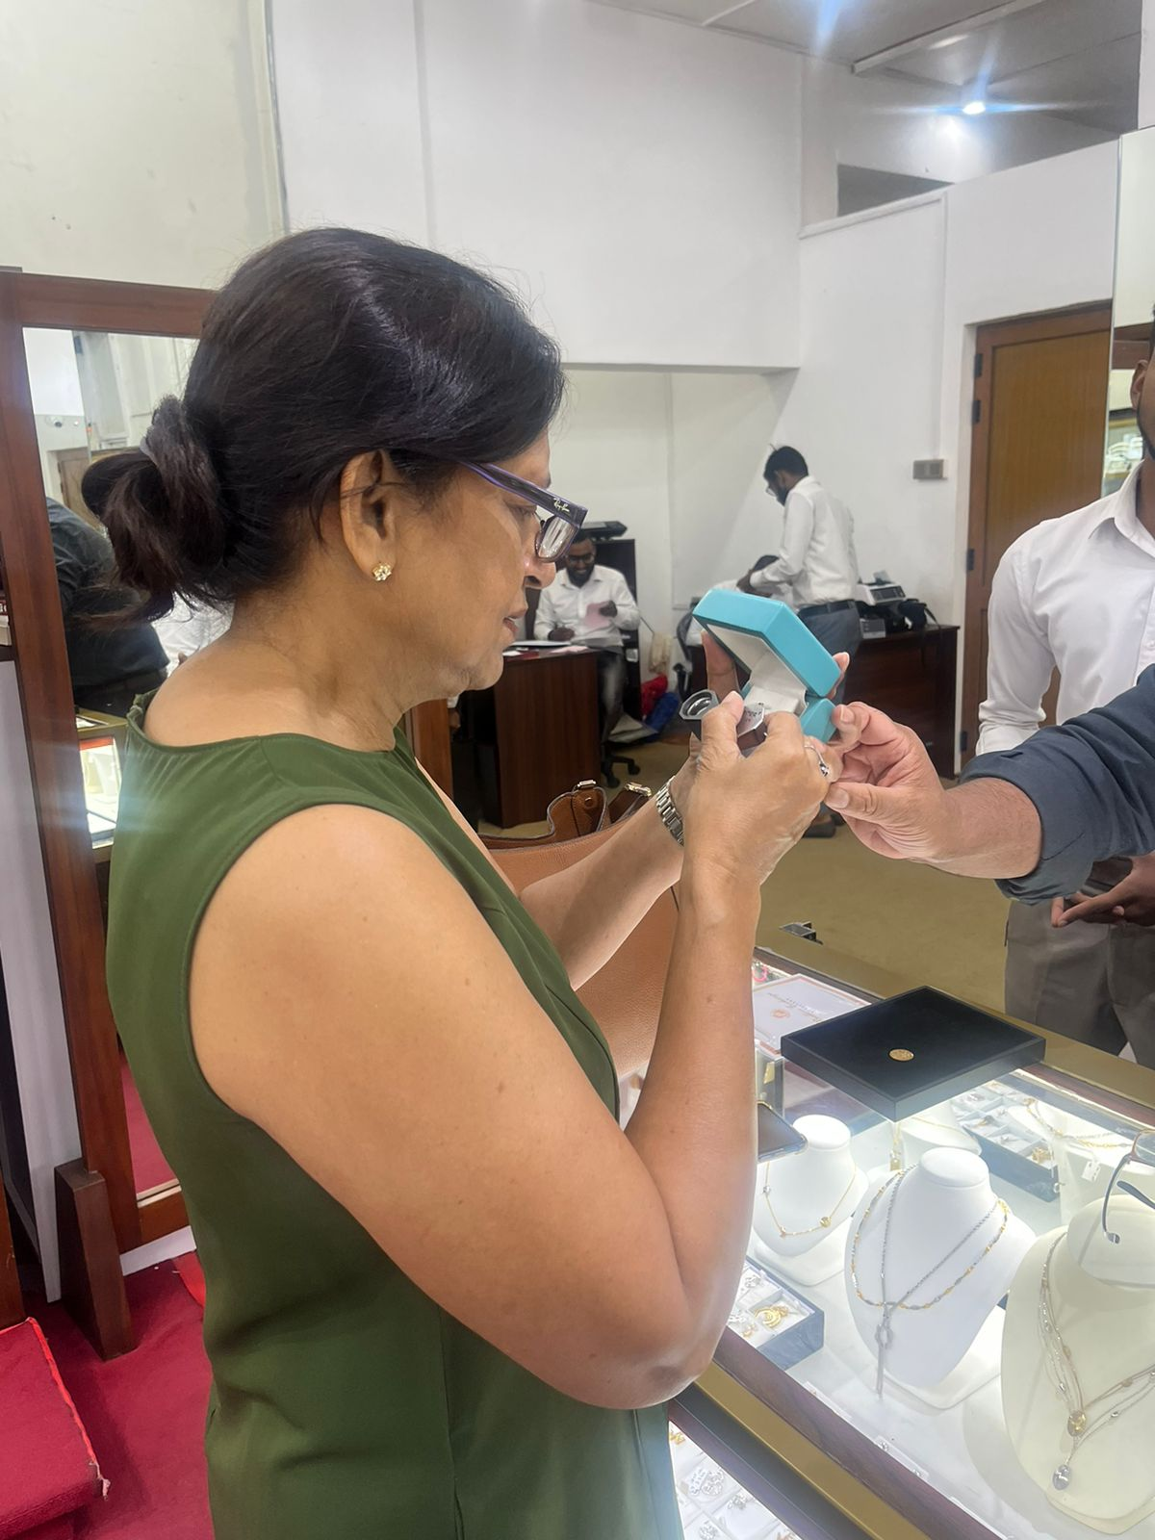
Sponsorship of the Gold Medal
Our own jewellery appraisers hard at work

Slide 51
Upcoming Events

Slide 52
Upcoming Events
ROC Book Read for Seniors – 24th August 2023
Beach Party – Nov 2023
Movie Premiere – Dec 2023
Christmas Party – Dec 2023

Slide 53
We launched our own social handles

Slide 54
Insta

Slide 55
Facebook

Slide 56
Website

Slide 57
Yes we have accomplished a lot but our work is still not done….

Slide 58
Math Lab Project 2023
Project Cost of furniture & fittings : Rs. 3.1 Mn
Loading……..

Slide 59
Math Lab Project 2023
Project Cost of furniture & fittings : Rs. 3.1 Mn
Rs. 1Mn raised to date

Slide 60
To donate log on to our website
www.bcppa.lk
or visit our donations desk today

Slide 61
Thank you for your participation & generous contributions!!
We look forward to your continued support!!

